Slide 1

HOUSE Price prediction project
BY : ARCHANA KUMARI

Slide 2
Business Problem Framing
Housing and Real estate Markets are one of the major contributor’s in a country’s economy . It is very large market and various companies are working in this domain. Data Science can play a vital role in solving problems related to this domain and can help the countries in their overall revenue , profits and improving their marketing strategies . Machine learning techniques can be used for achieving business goals for this housing companies . Our Problem is related to one of such U.S based housing company named Surprise Housing which want to enter Australian Market . The company want to use Data Analytics to purchase houses at a price below their actual values and flip them at a higher prices. The company has collected a dataset from the sale of houses in Australia . The company is looking at prospective properties to buy houses to enter the market . we will build a model using Machine Learning to predict the actual value of the prospective properties and it will help the company to decide whether to invest in property or not.

Slide 3
Conceptual Background of the Domain Problem
Trends in housing prices indicate the current economic situation and also are a concern to the buyers and sellers. There are many factors that have an impact on house prices, such as the number of bedrooms and bathrooms. House price depends upon its location as well. A house with great accessibility to highways, schools, malls, employment opportunities, would have a greater price as compared to a house with no such accessibility. Predicting house prices manually is a difficult task and generally not very accurate, hence there are many systems developed for house price prediction.

Slide 4
Undertaken
Growing unaffordability of housing has become one of the major challenge for countries around the world. In order to gain a better understanding of the commercialized housing market we are currently facing , we want to figure out what are the top influential factors of the housing price. Apart from the more obvious driving forces such as the inflation and the scarcity of land, there are also a number of variable that are worth looking into. Therefore , we choose to study the house price prediction., which enables us to dig into the variables in depth and to provide a model that could more accurately estimate house prices. In this way, people could make better decision when it comes to home investment.
Our objective is to discuss the major factors that effect housing price and make precise prediction for it. We use 80 explanatory variables including almost every aspect of residential homes in Australia. Methods of both statistical , regression models and machine learning models are applied and firther compared according to their performance to better estimate the final price of each house. The model provides price prediction based on similar comparable of people’s dream house, which allow both buyers and sellers to better negotiate home prices according to market trend.

Slide 5
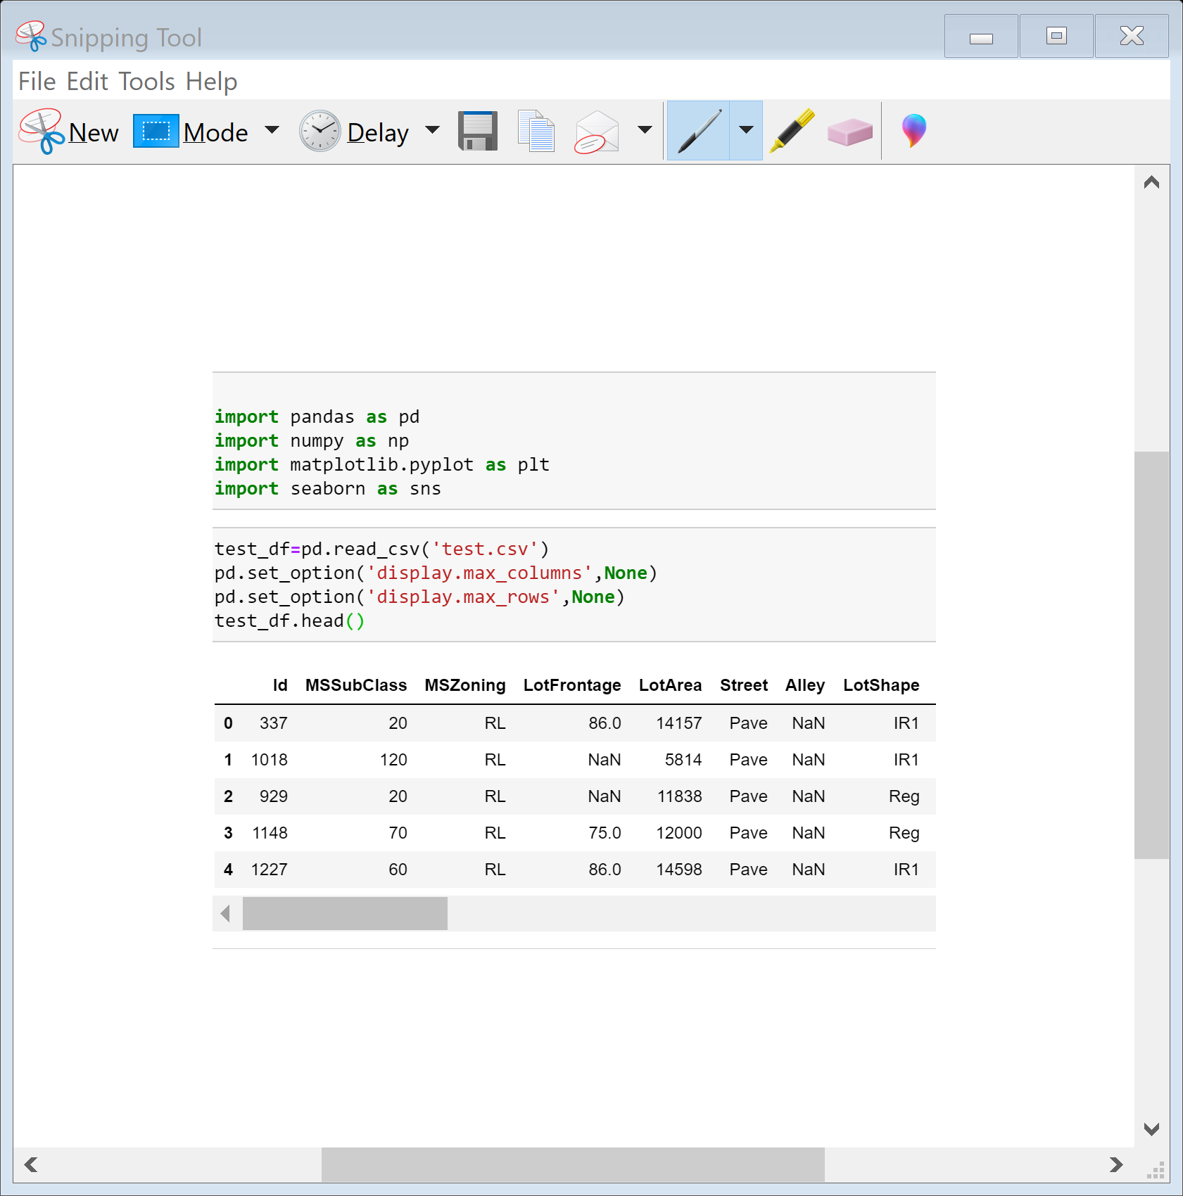
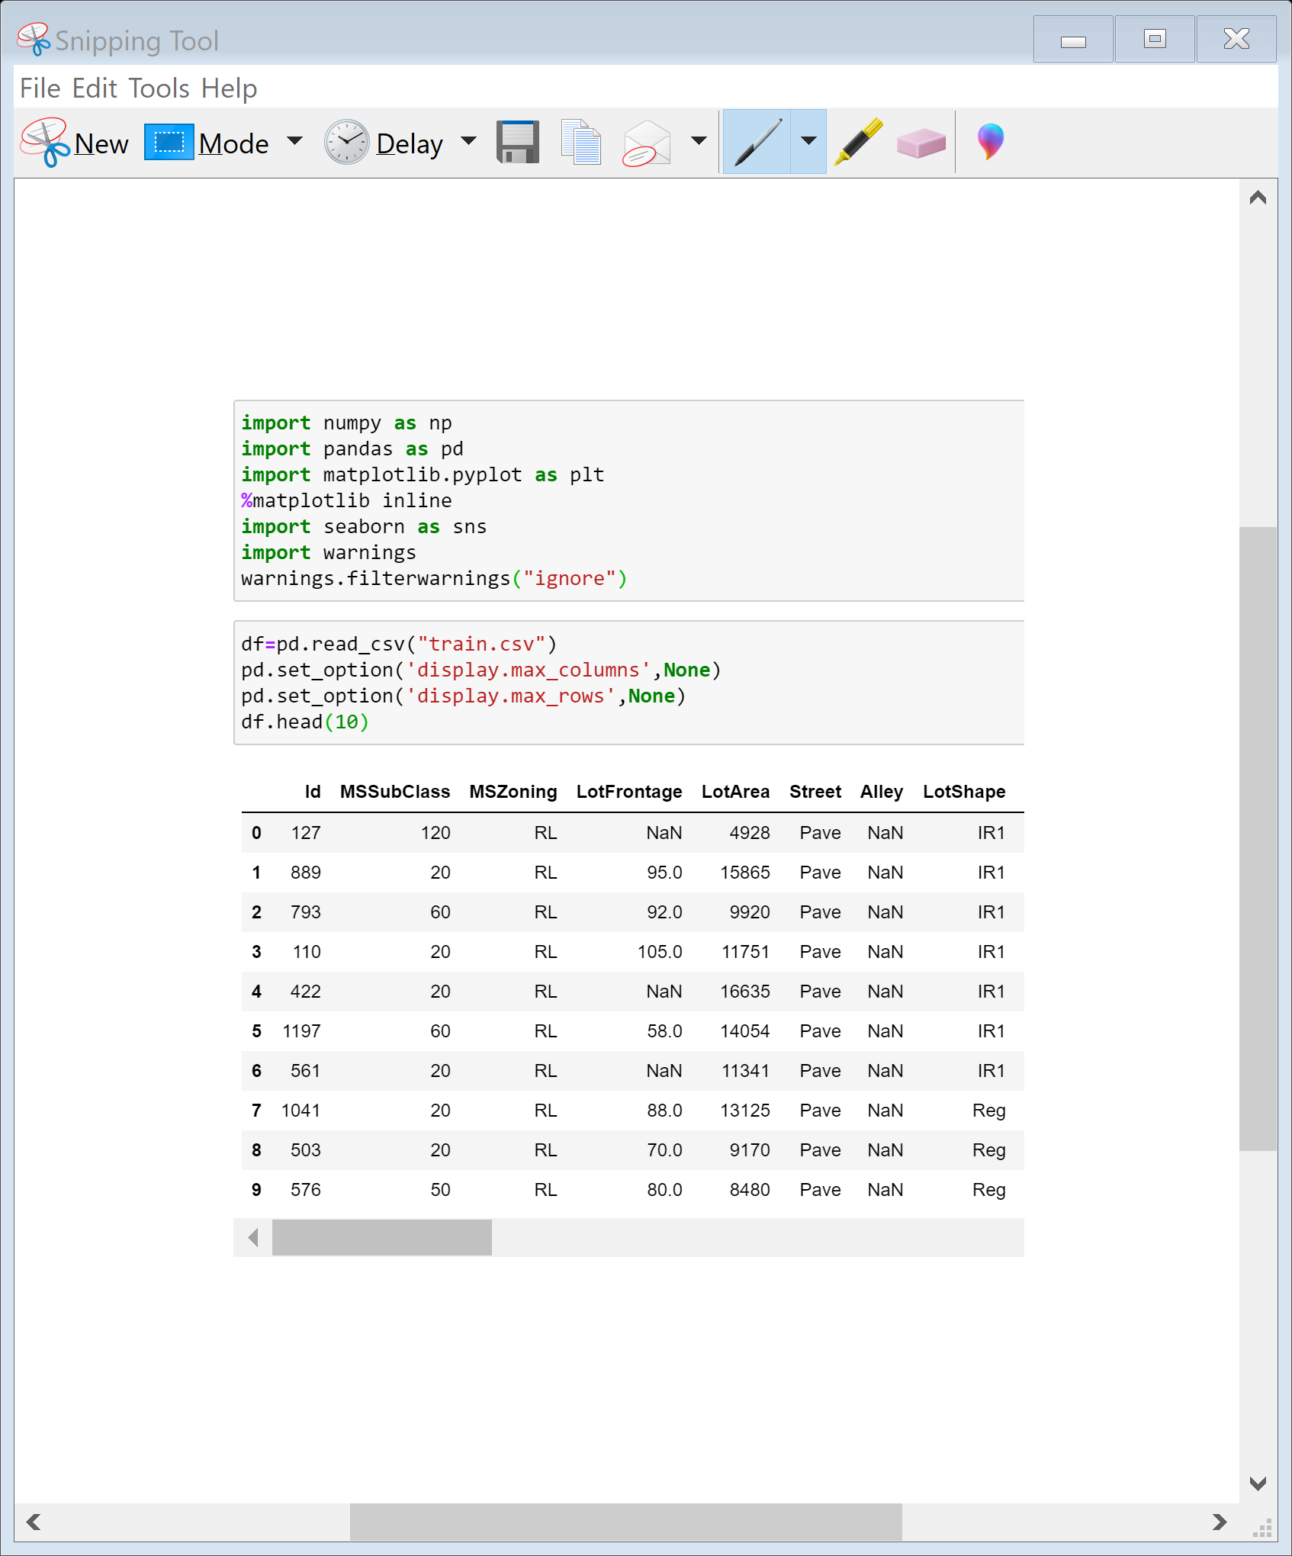
Loading Necessary libraries and Train and test dataset

Slide 6
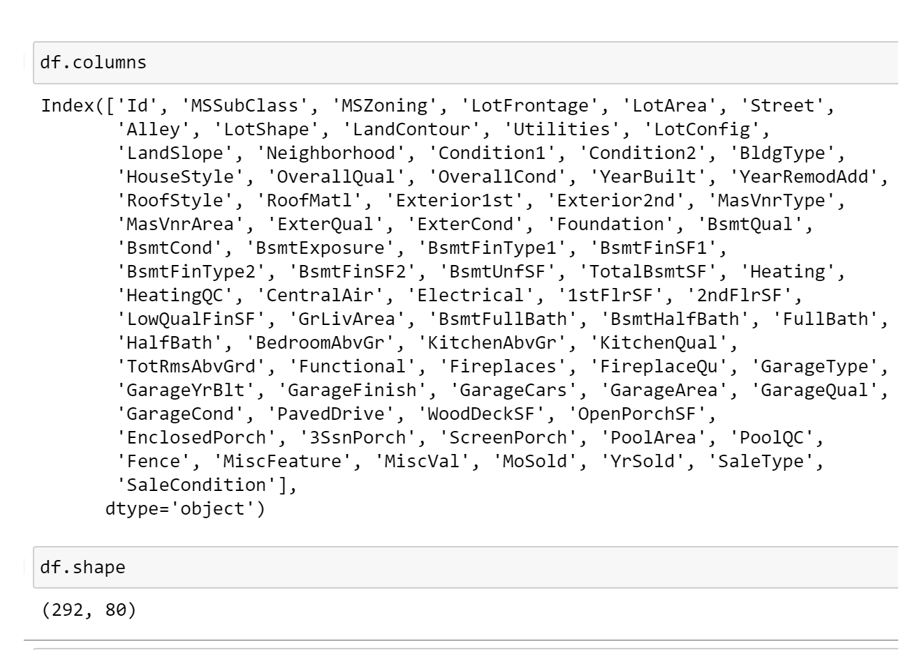
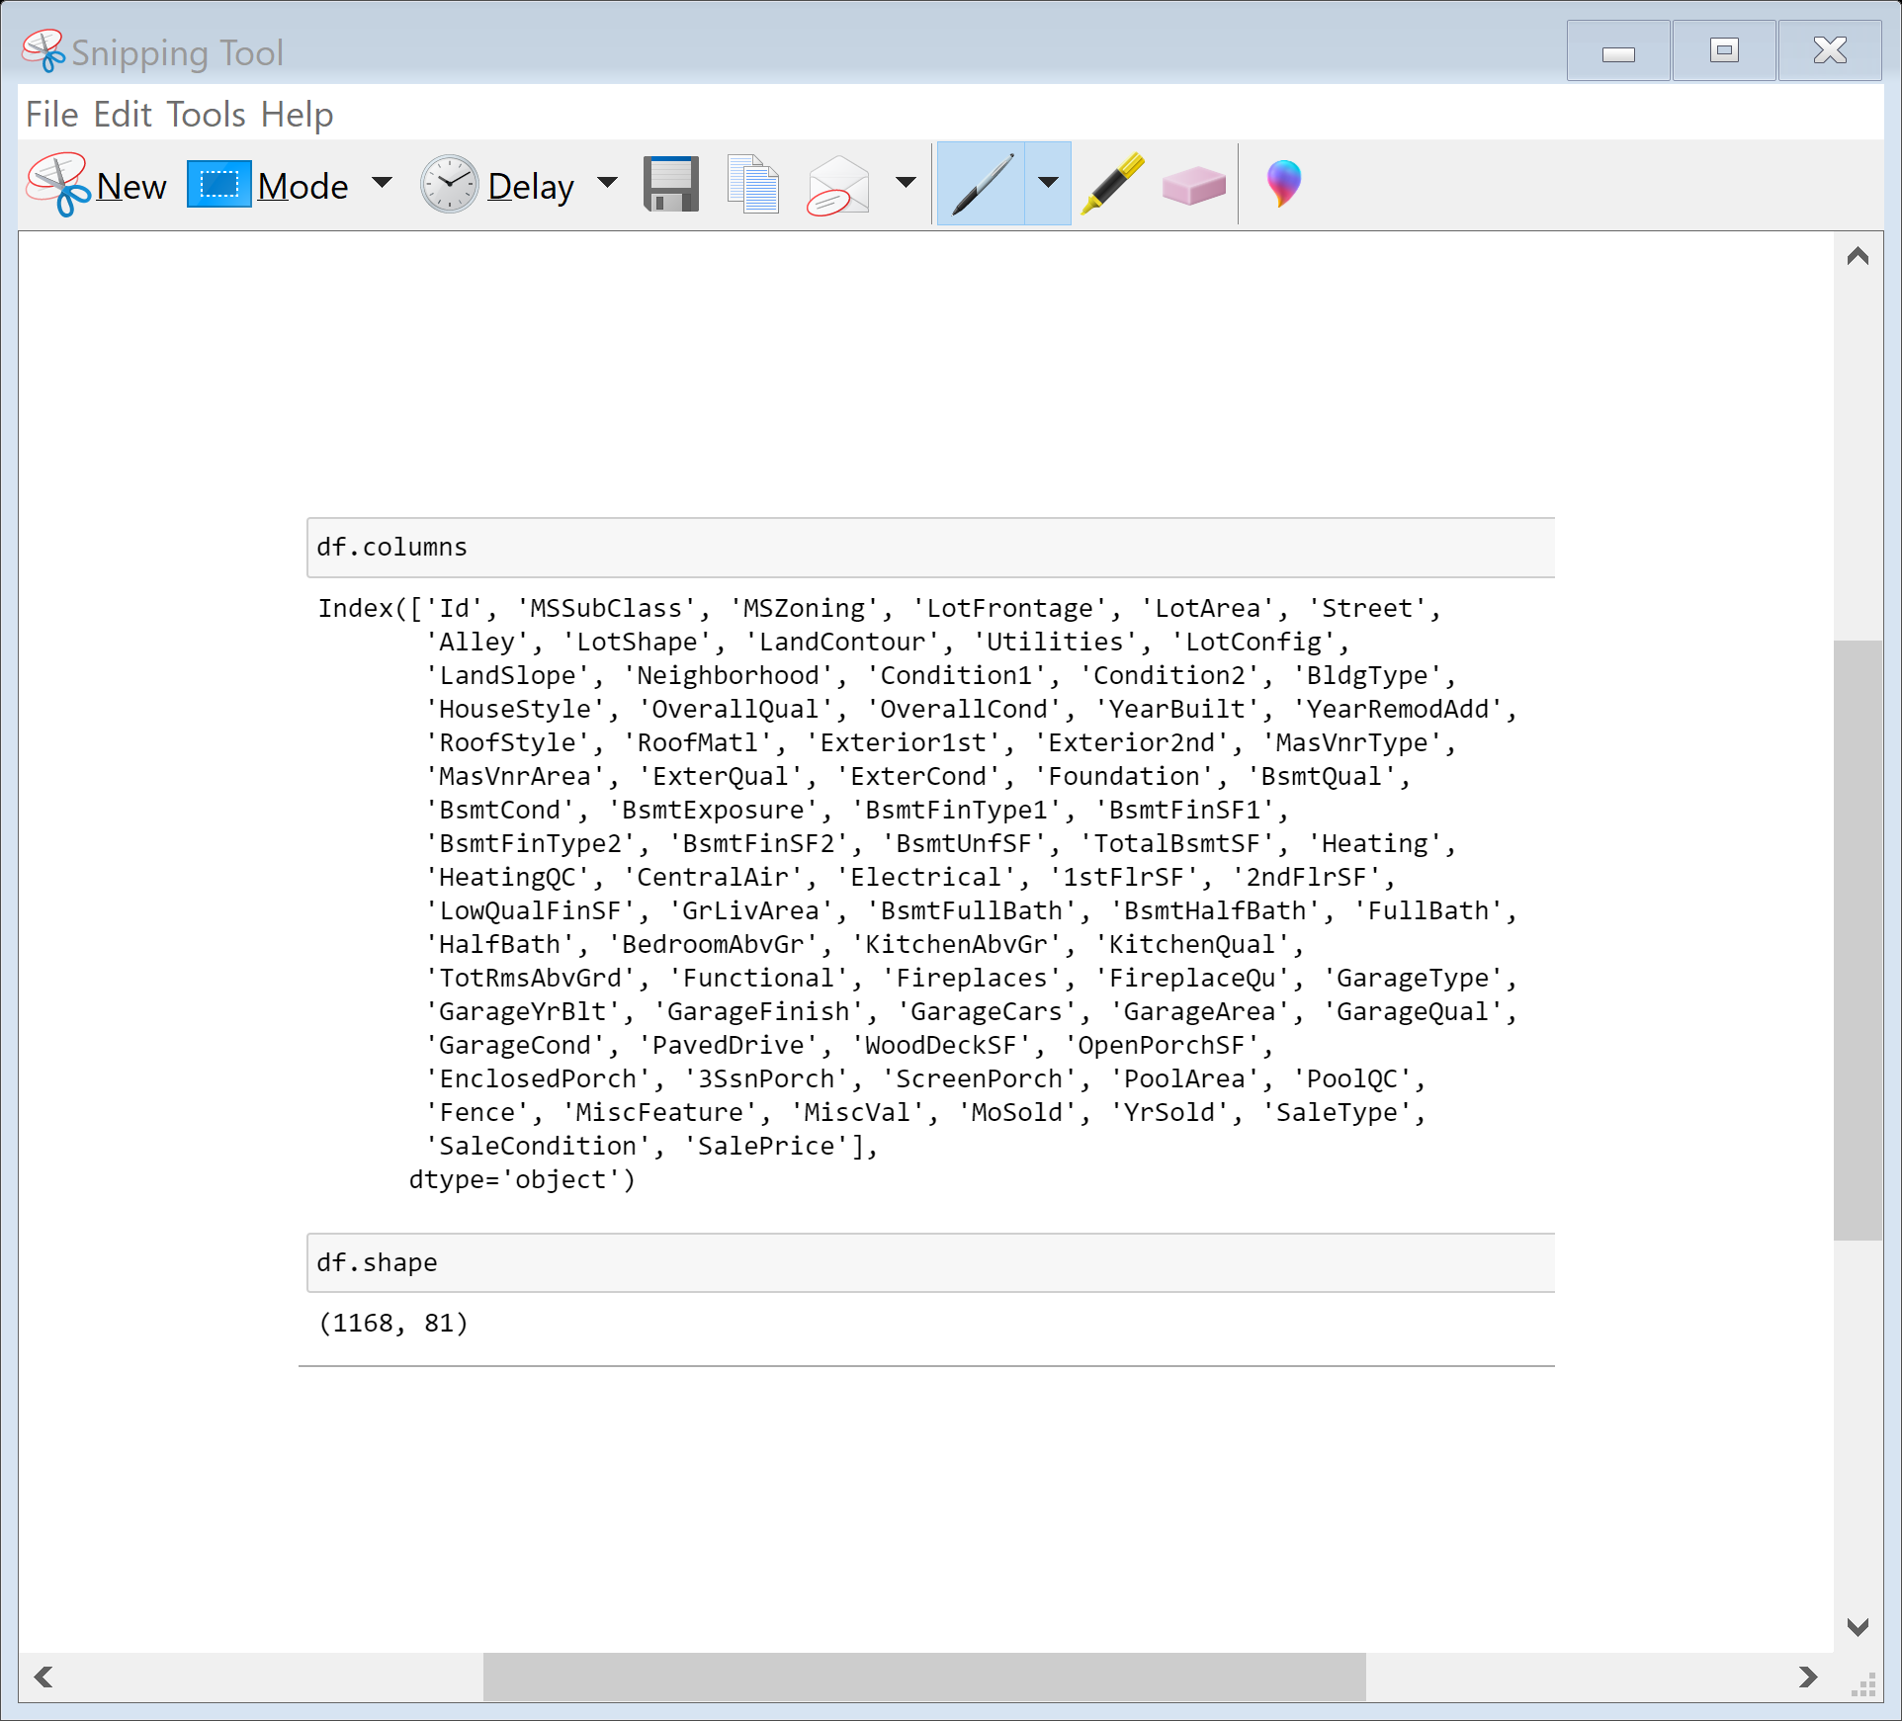
Let’s check the name of the columns , shape and information about the both dataset

Slide 7
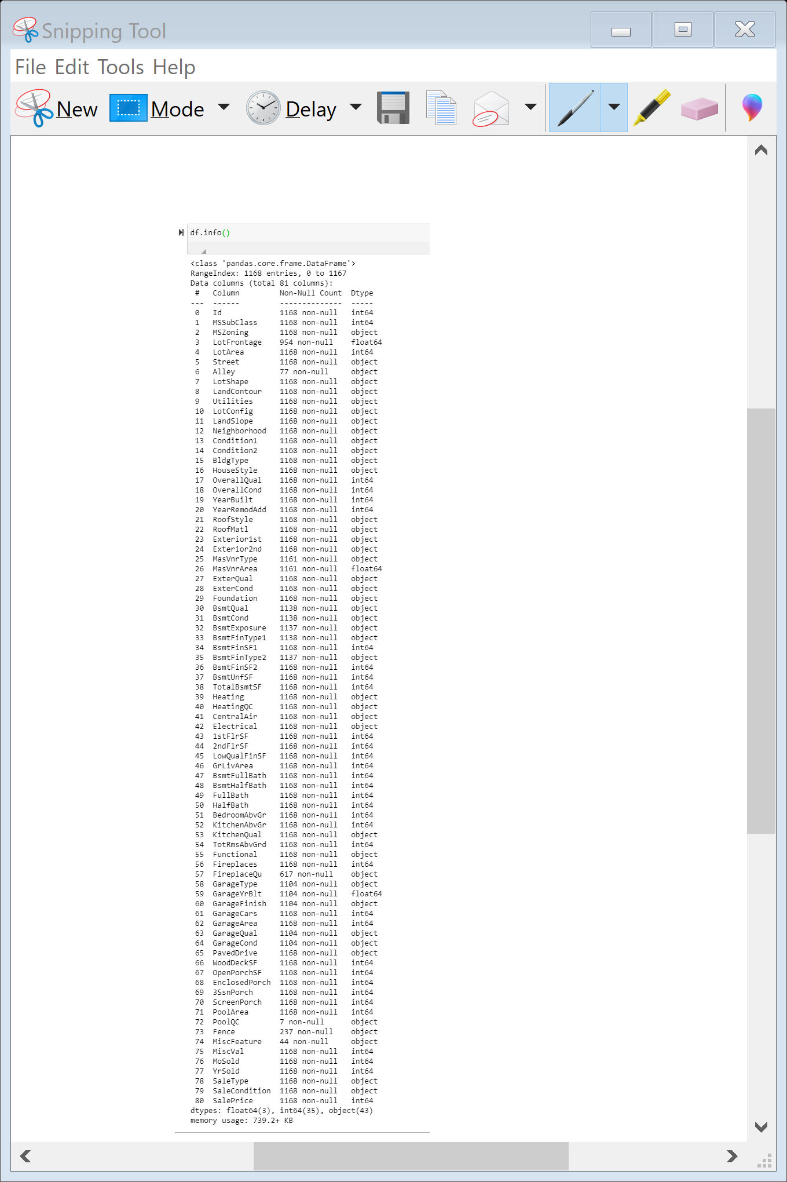
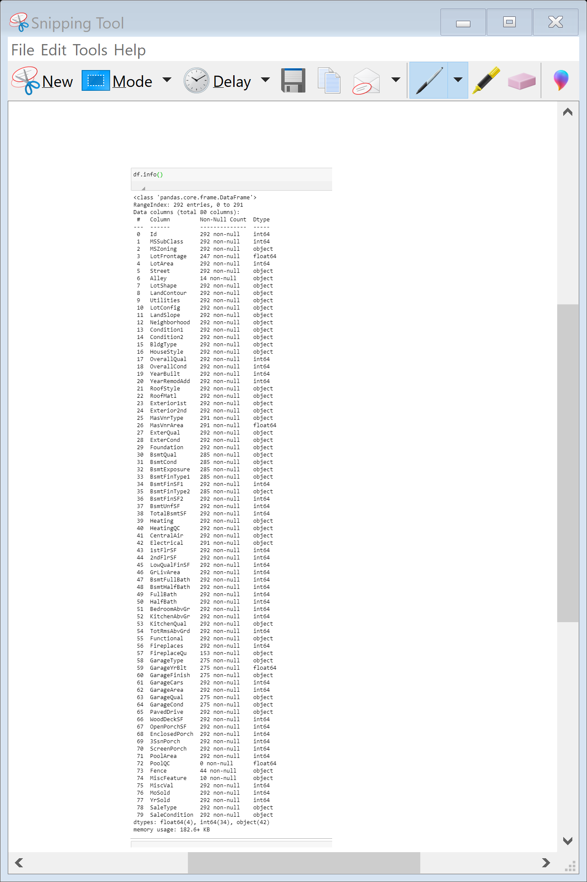
Here we can see that the target variable sales price is missing in test dataset

Slide 8
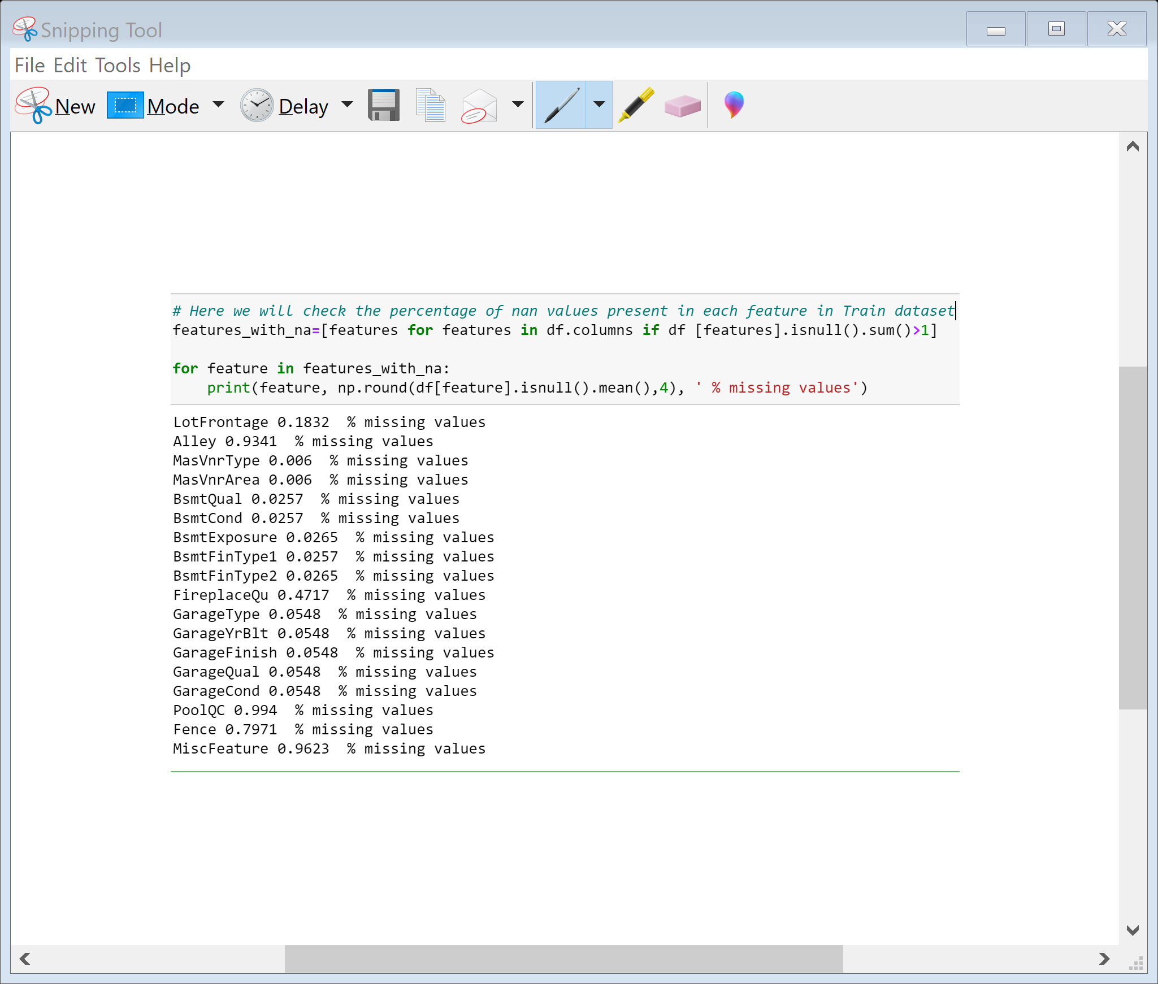
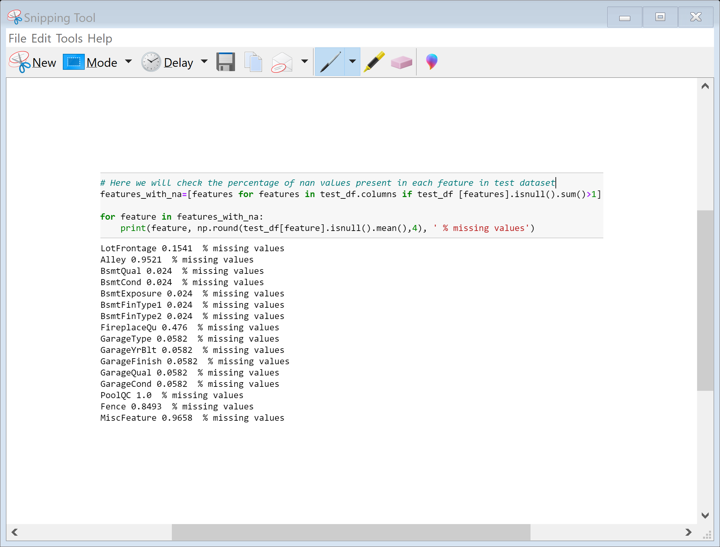
Lets check the null values in both the data set
We can see that both the dataset contains lots of null values and some features have more that 80% of null values

Slide 9
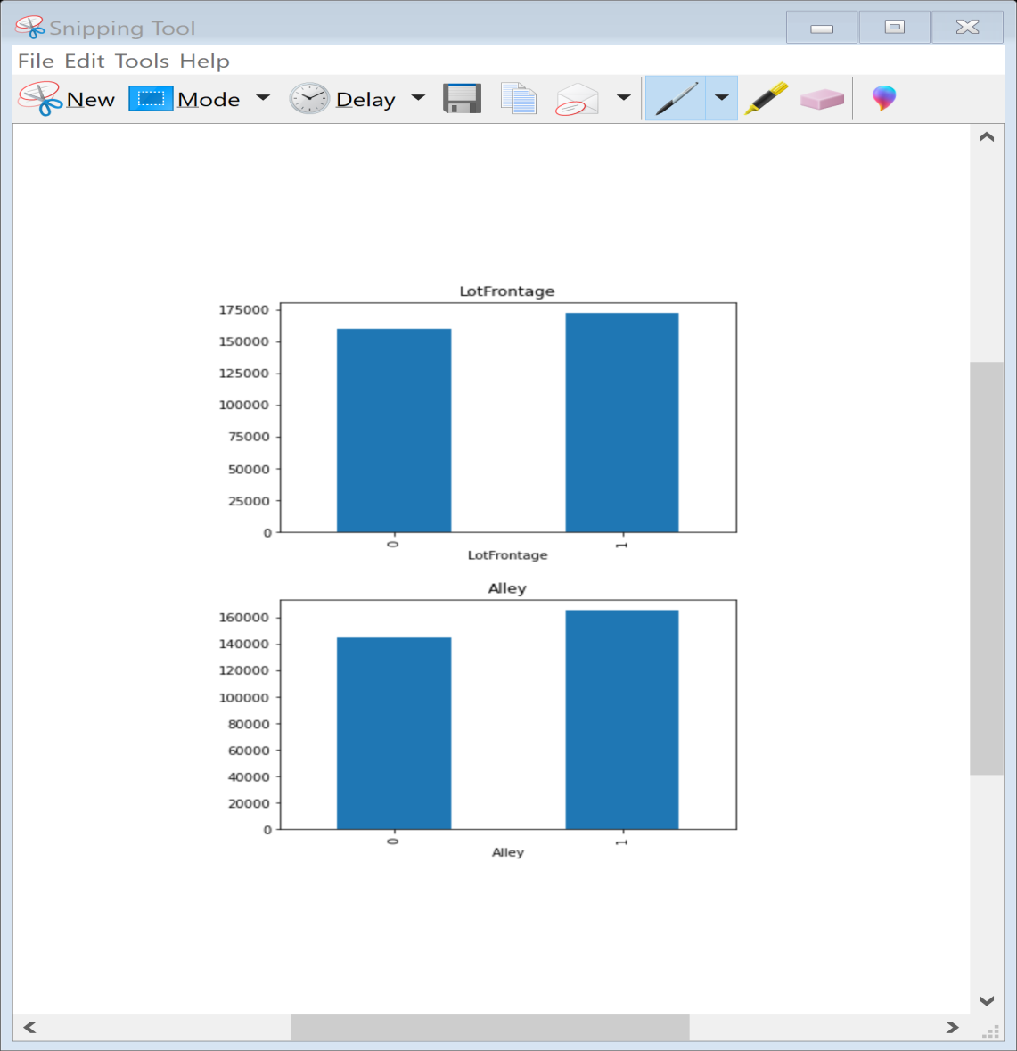
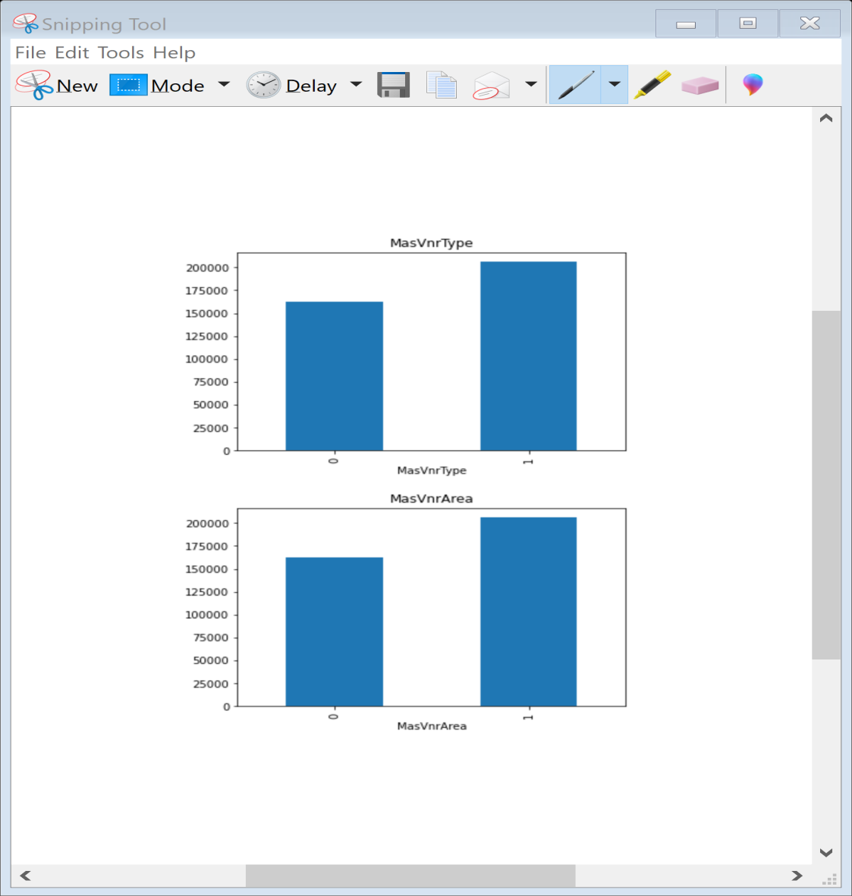
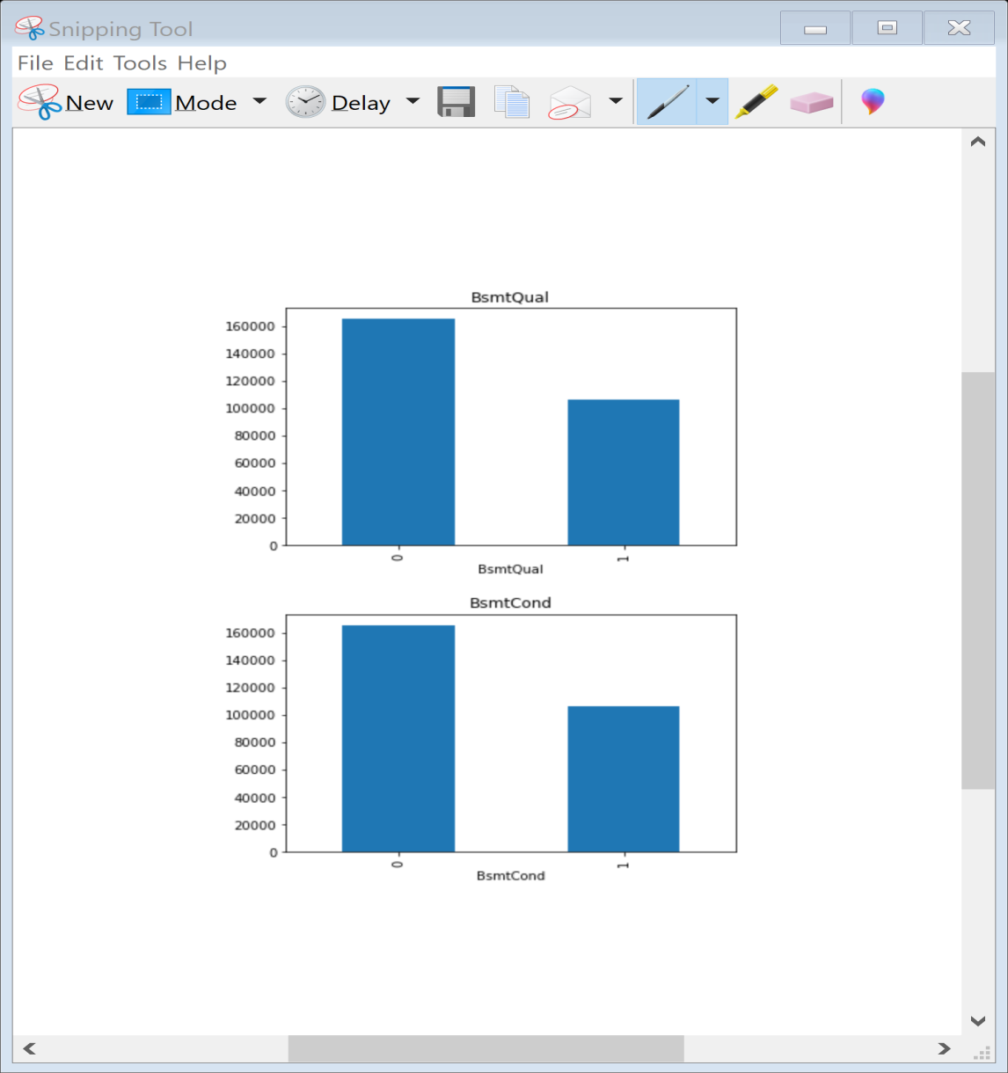
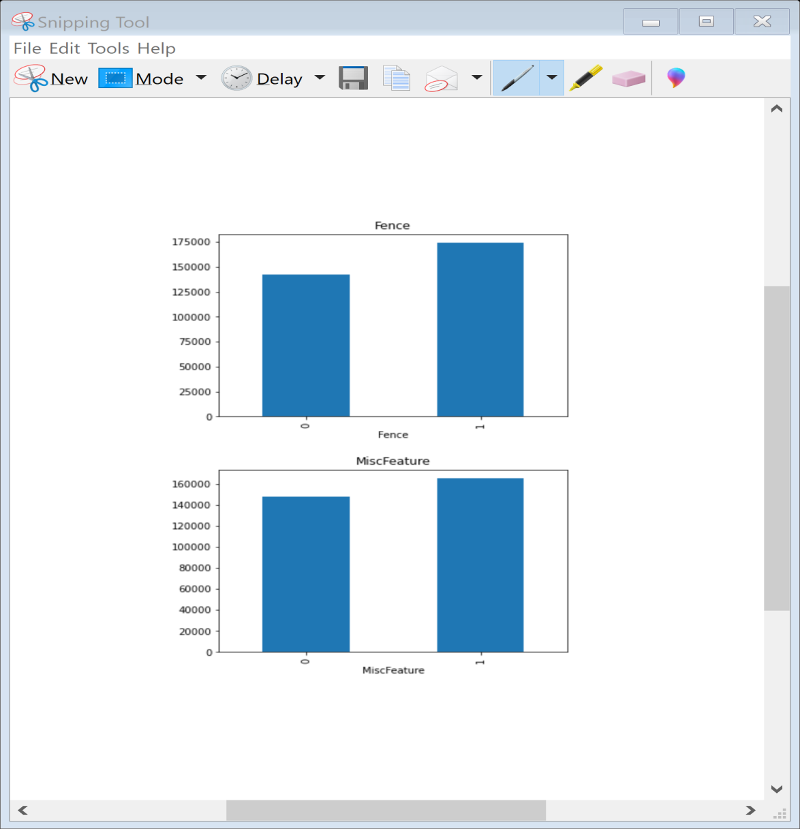
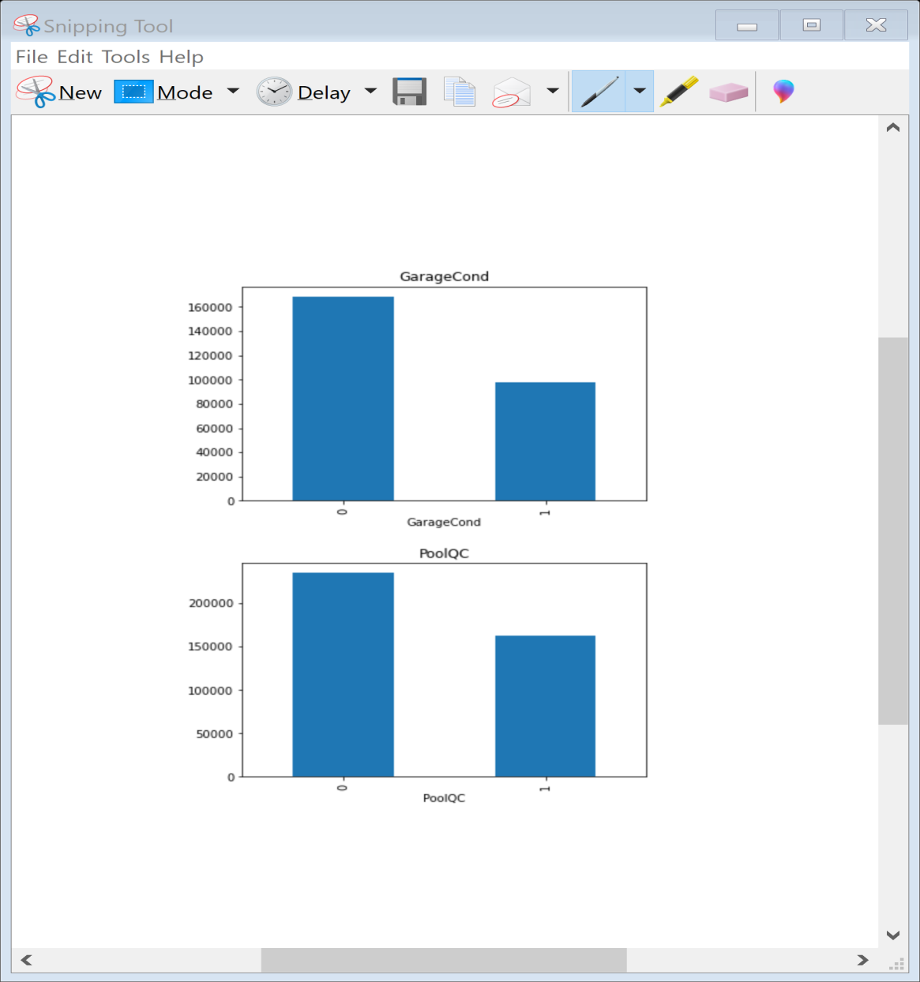
Visualization
Since their are many missing values, we need to find the relationship between missing values and Sales price
Here variable 1 indicates missing and 0 indicates its not With the relation between the missing values and the dependent variable is clearly visible.
So We need to replace these nan values with something meaningful. we can see that features like lotfrontage, alley has nan values, because of this the median sale price is increasing so we will replace it with some meaningful later on.

Slide 10
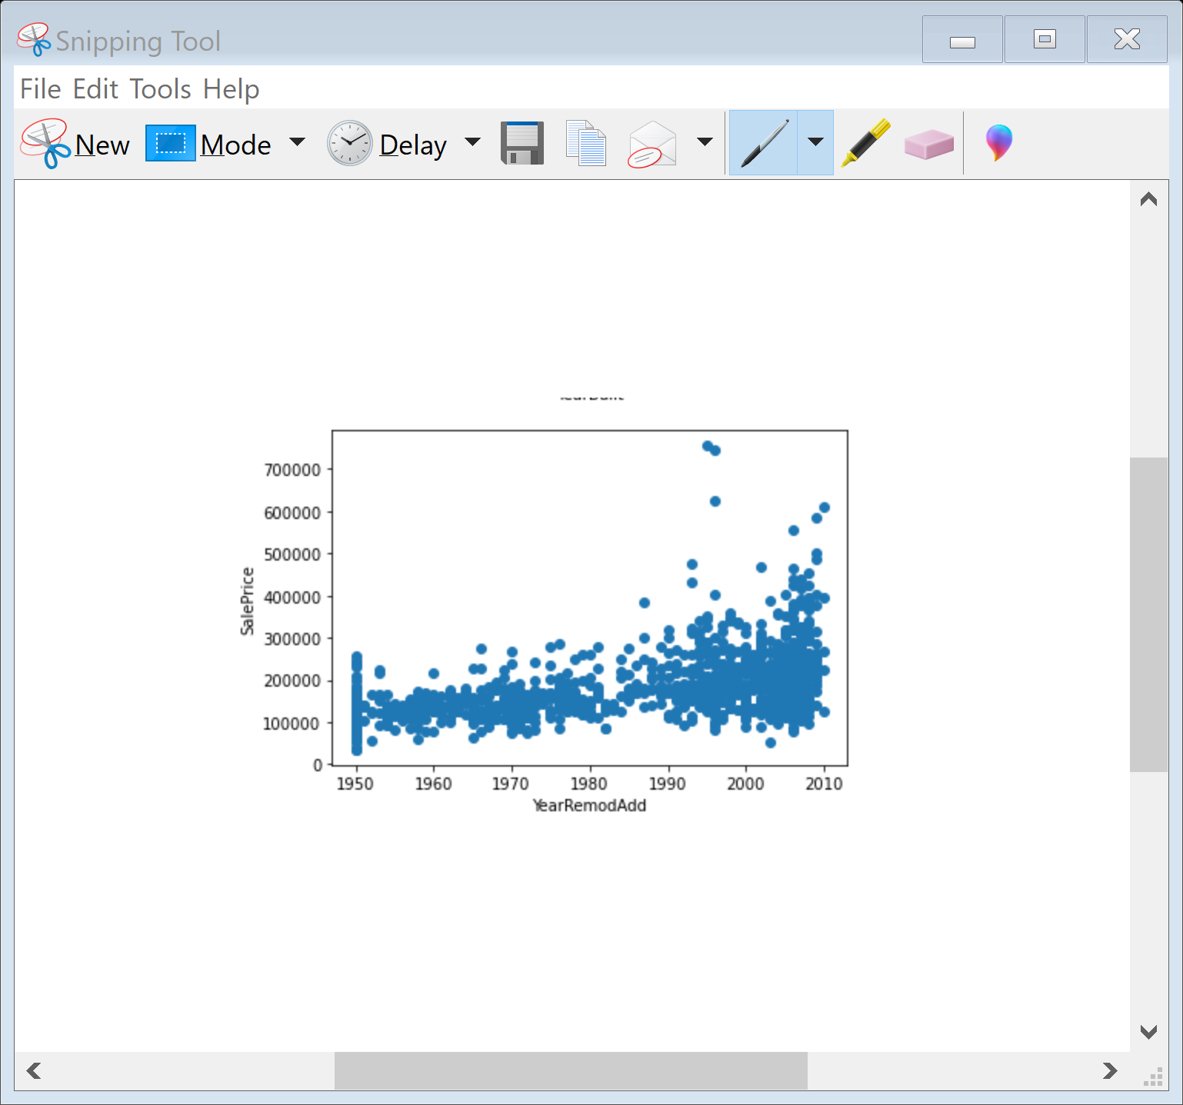
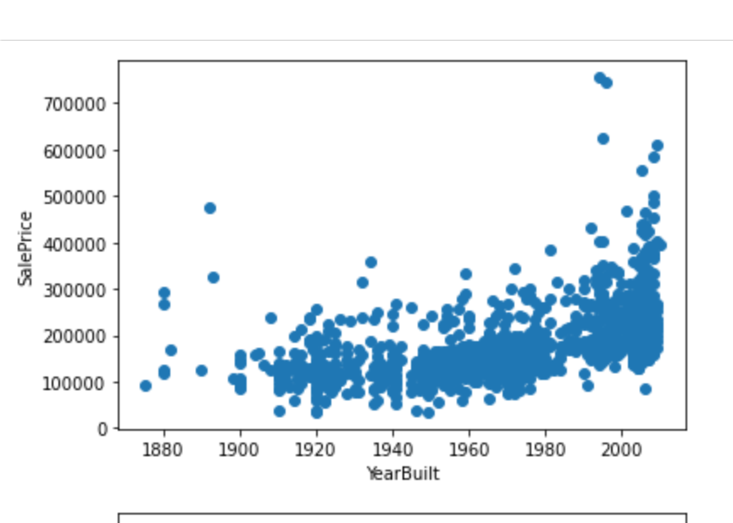
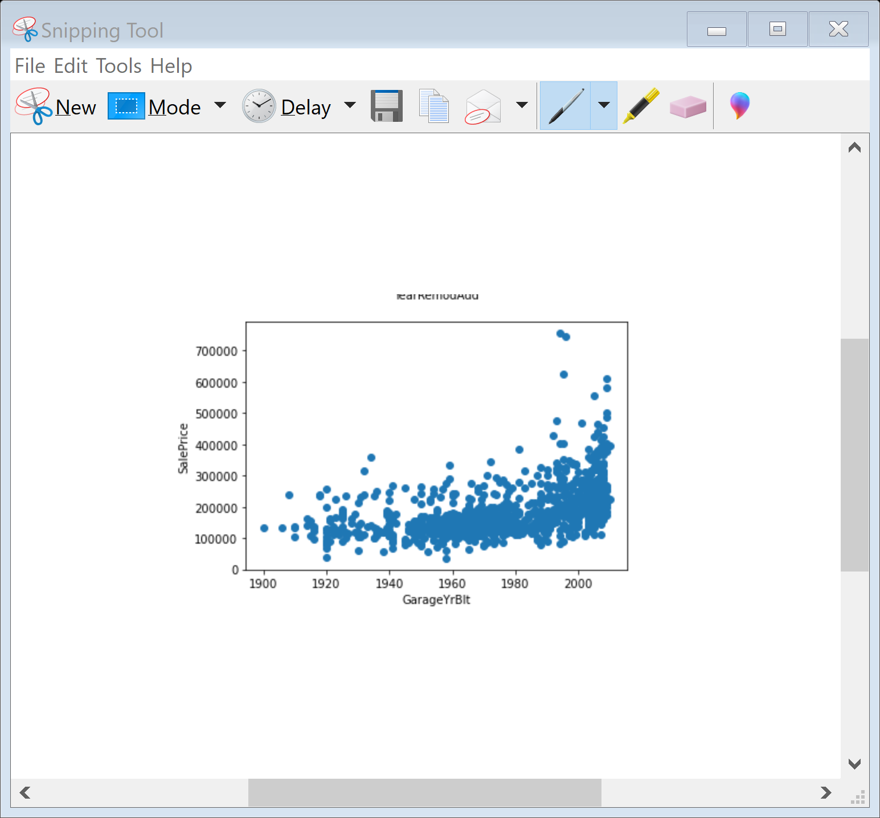
Here we can see that year built, The house which was built earlier has less price the the recent one. Year of remodification if the year is 60 the price is very less as compared to 0 to 10 years. Same thing happening with garage built year.

Slide 11
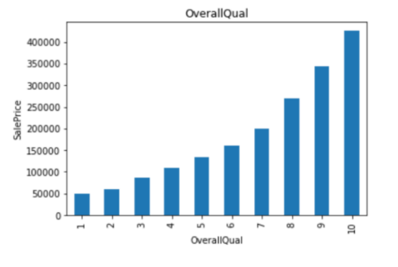
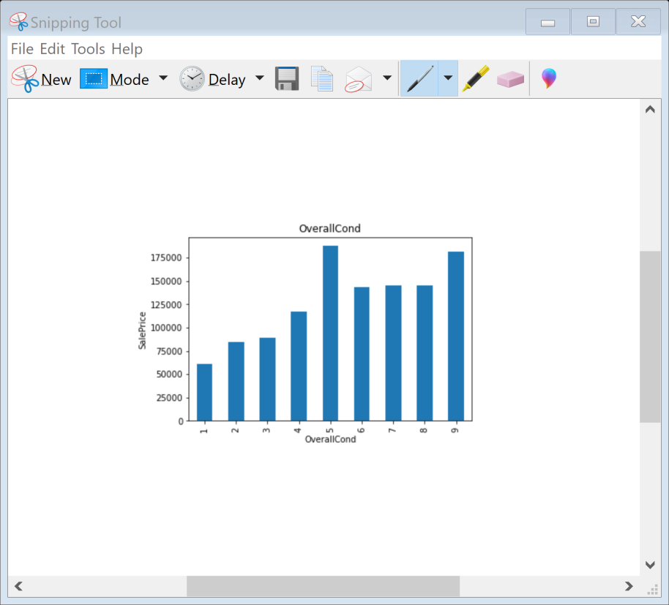
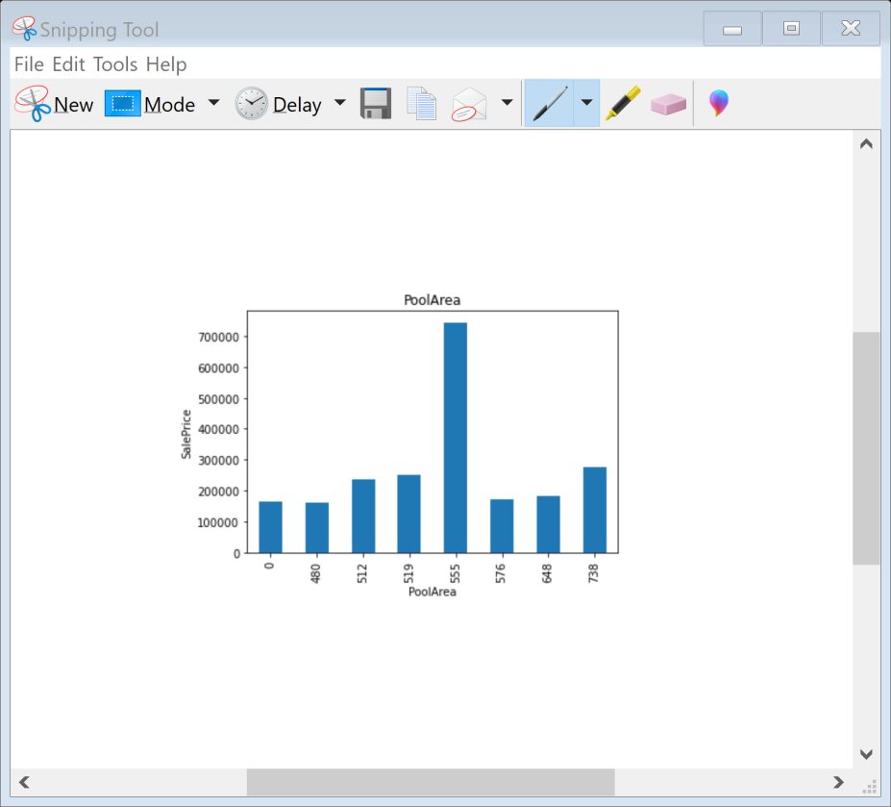
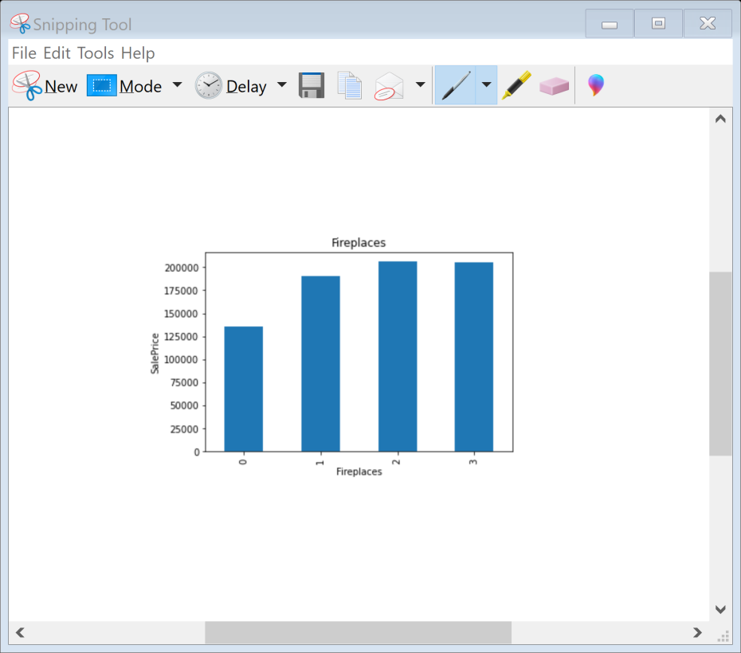
As we can see the overall quality is increasing the price is high. If the overall condition of the house is average the price is more that others. As there is increase in no of fire places the price of house is rising. As the house has a pool area of 555 sq feet the price of the house is more as compared to others.

Slide 12
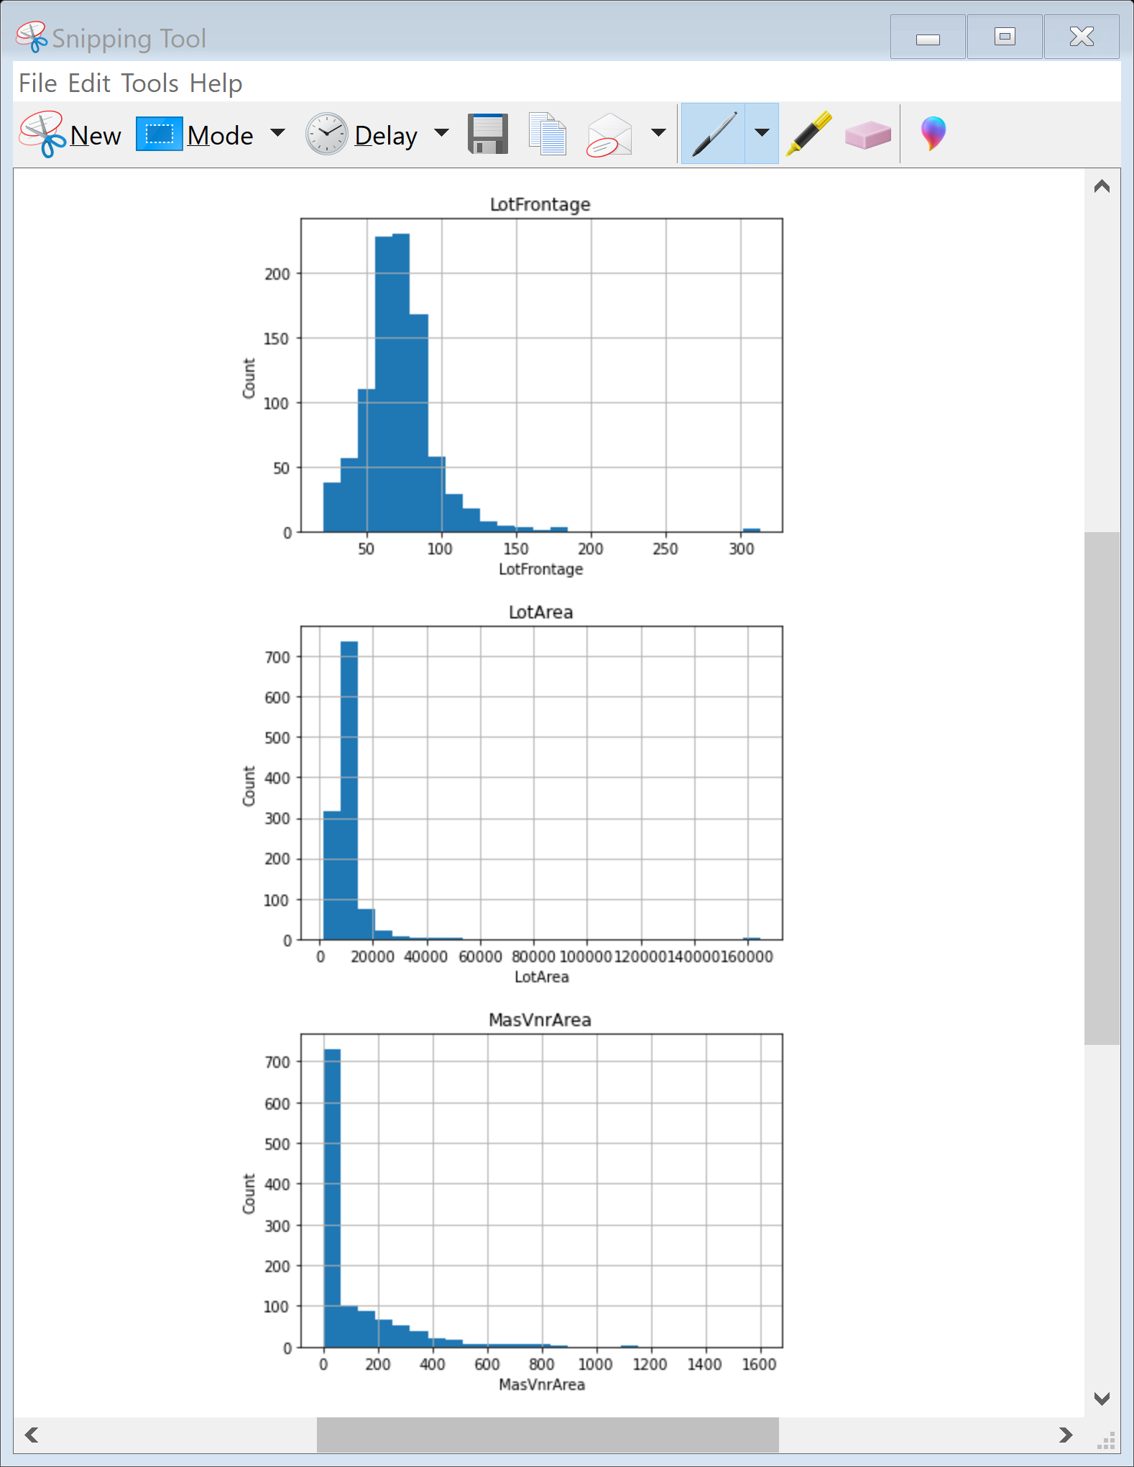
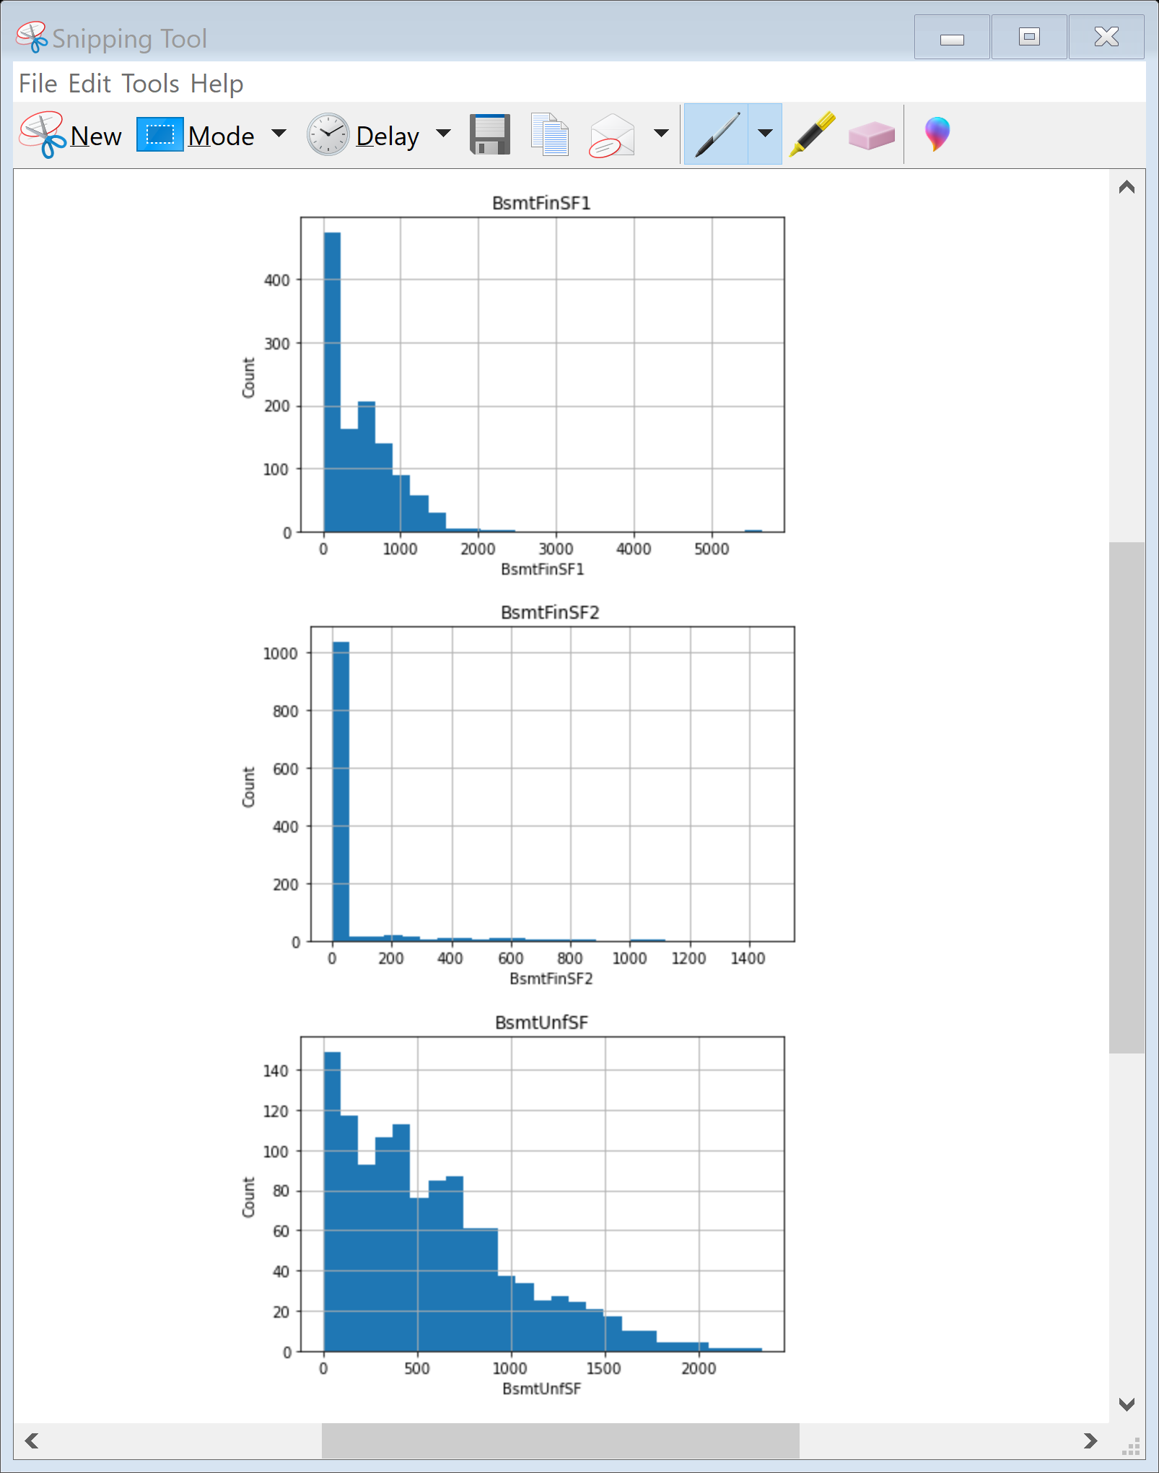
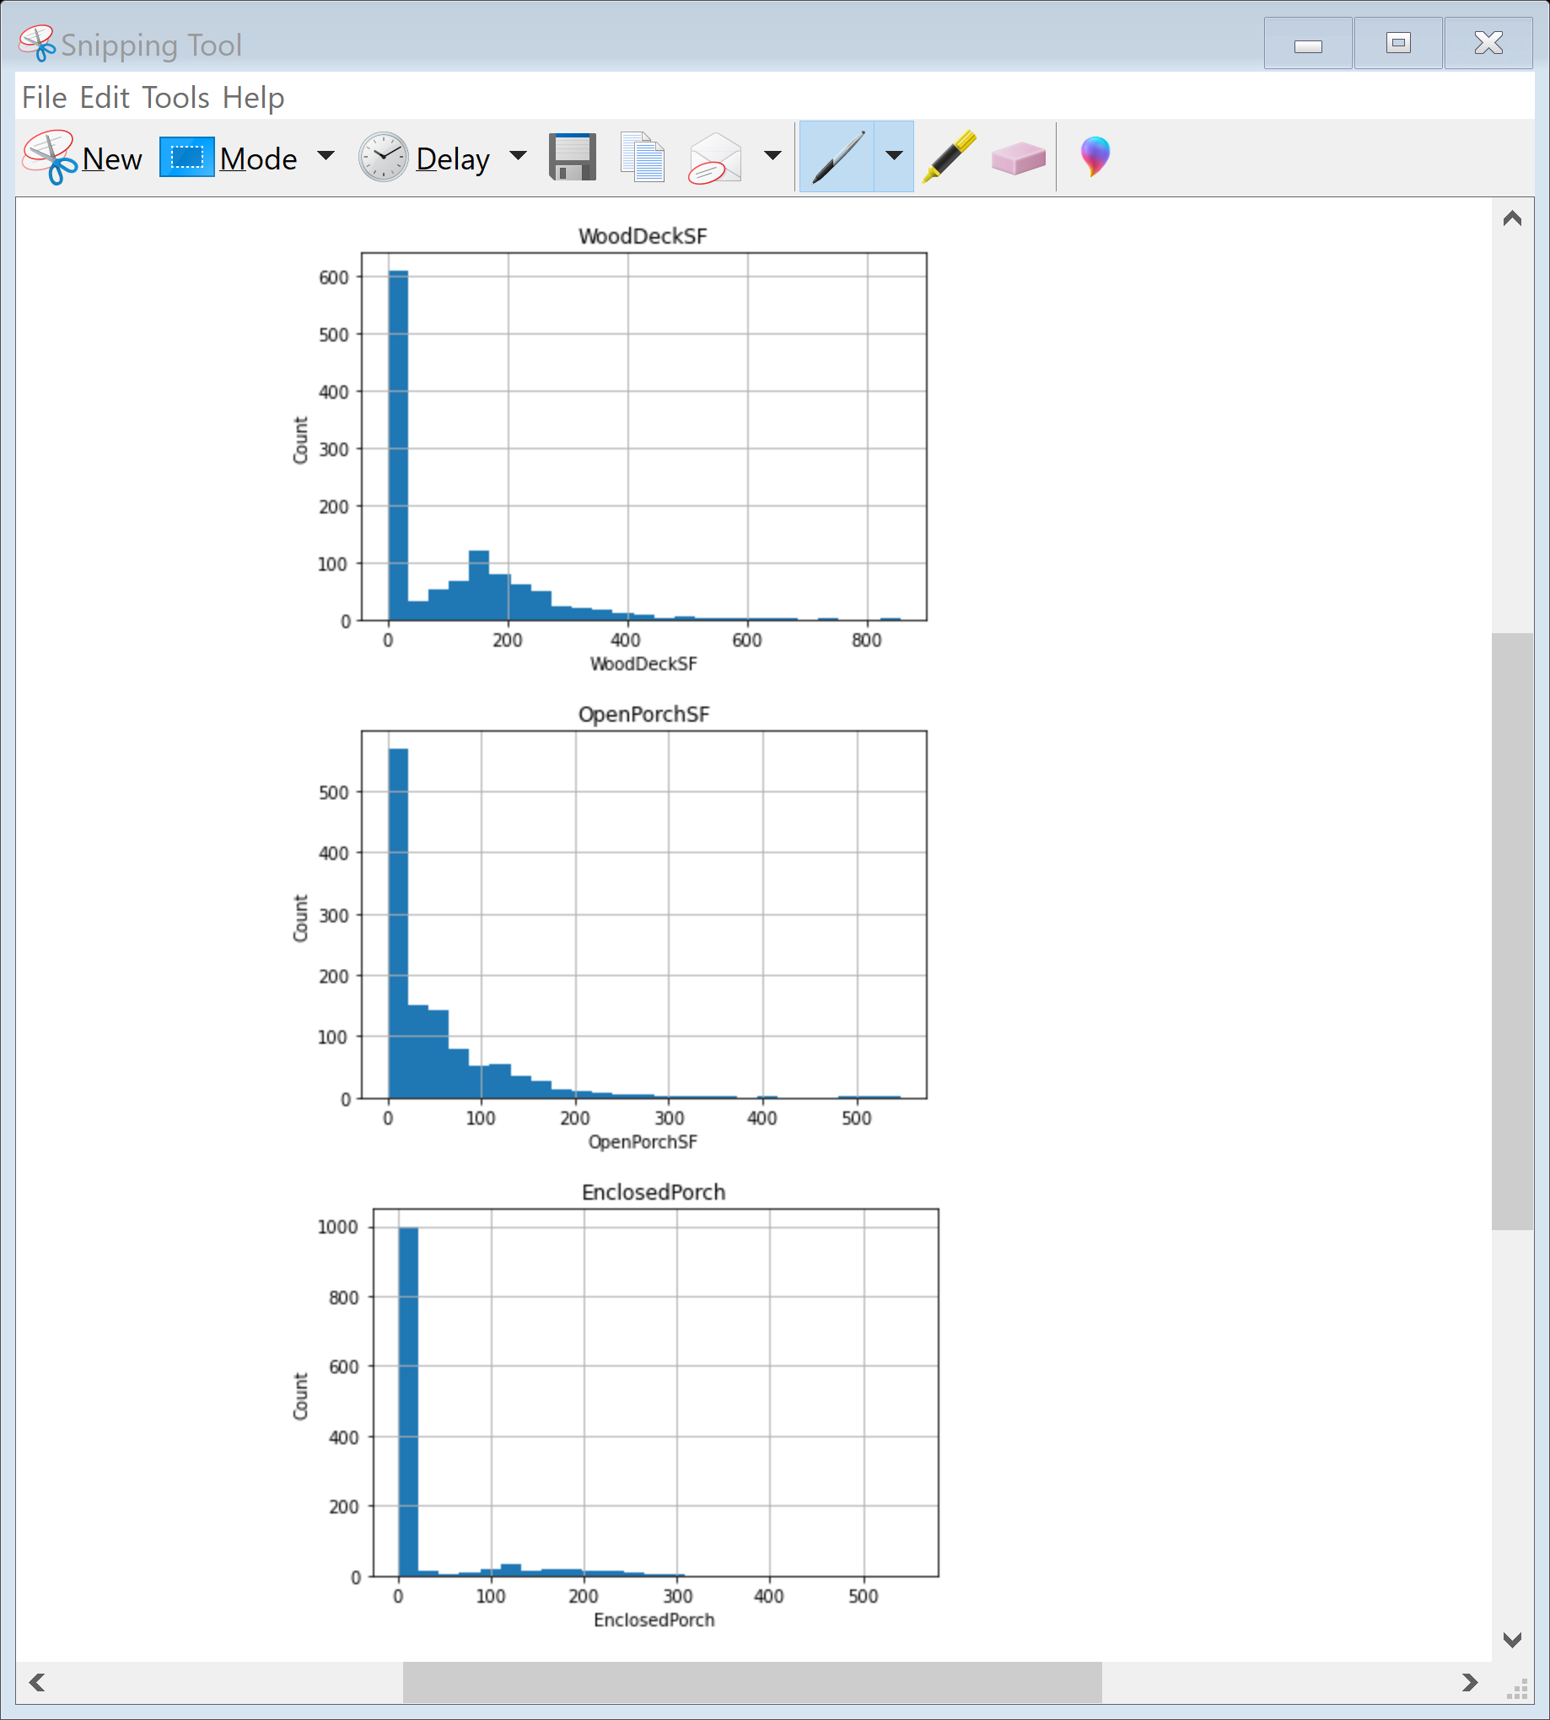
Here you can see that the data is skewed so we will perform log transformation to reduced skewness of the data.

Slide 13
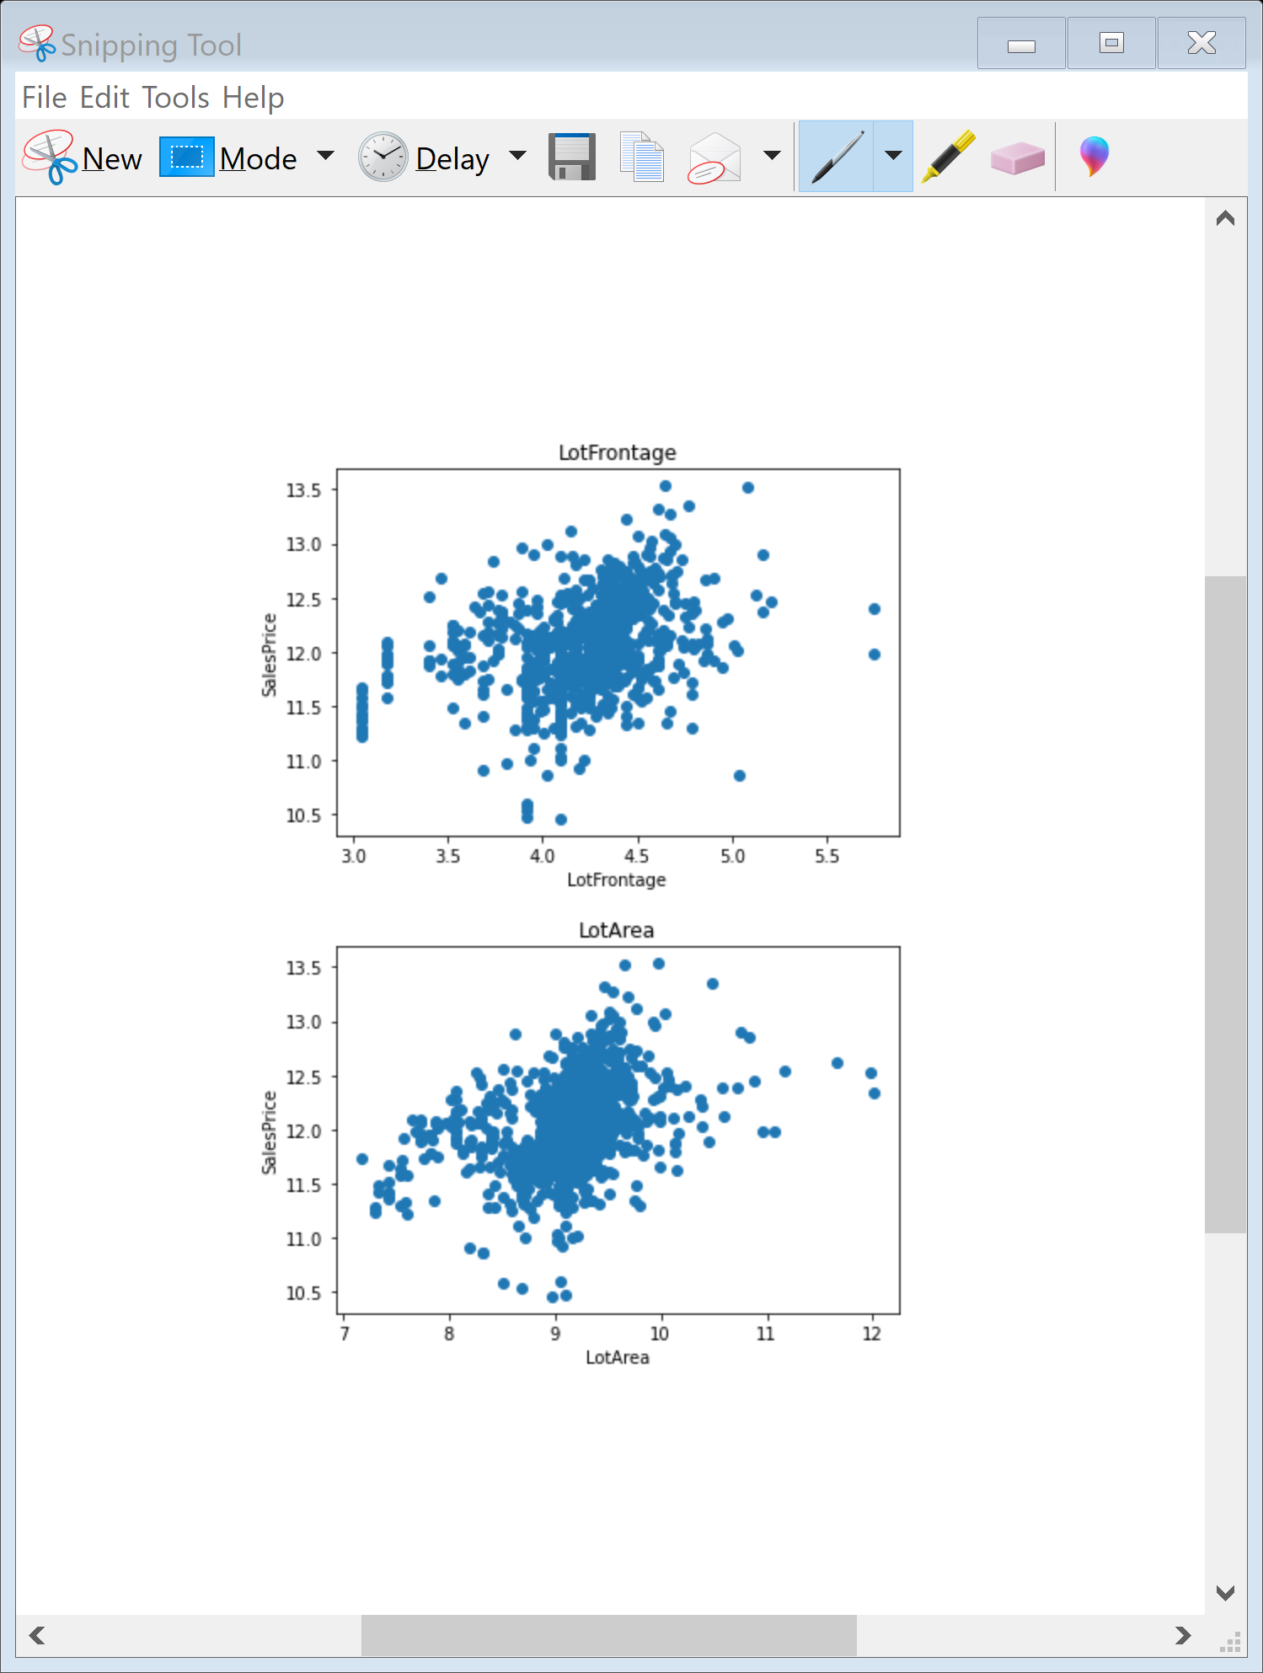
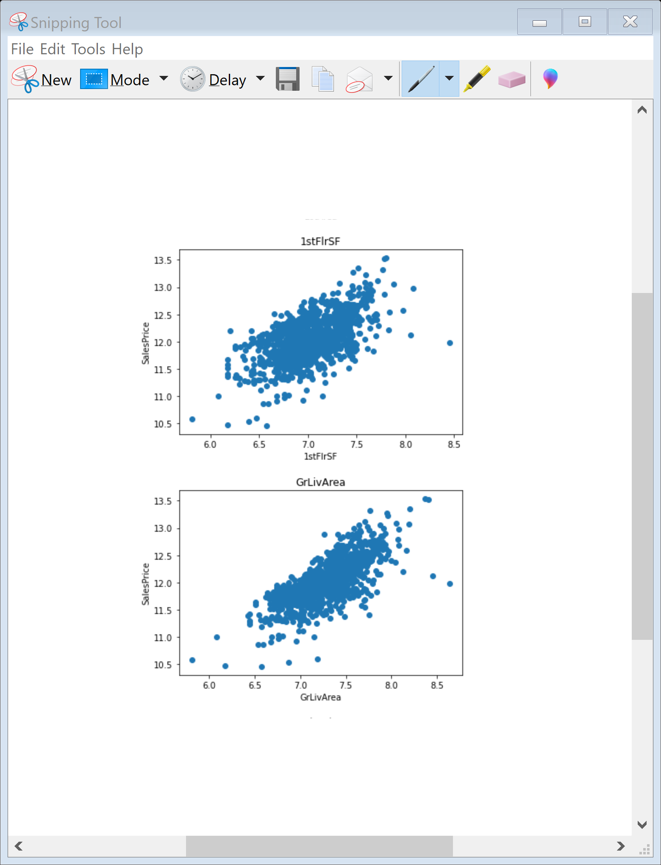
So after applying log transformation its giving monotonic relationship, as lotfrontage, lotarea, Grlivarea is increasing the price is increasing.

Slide 14
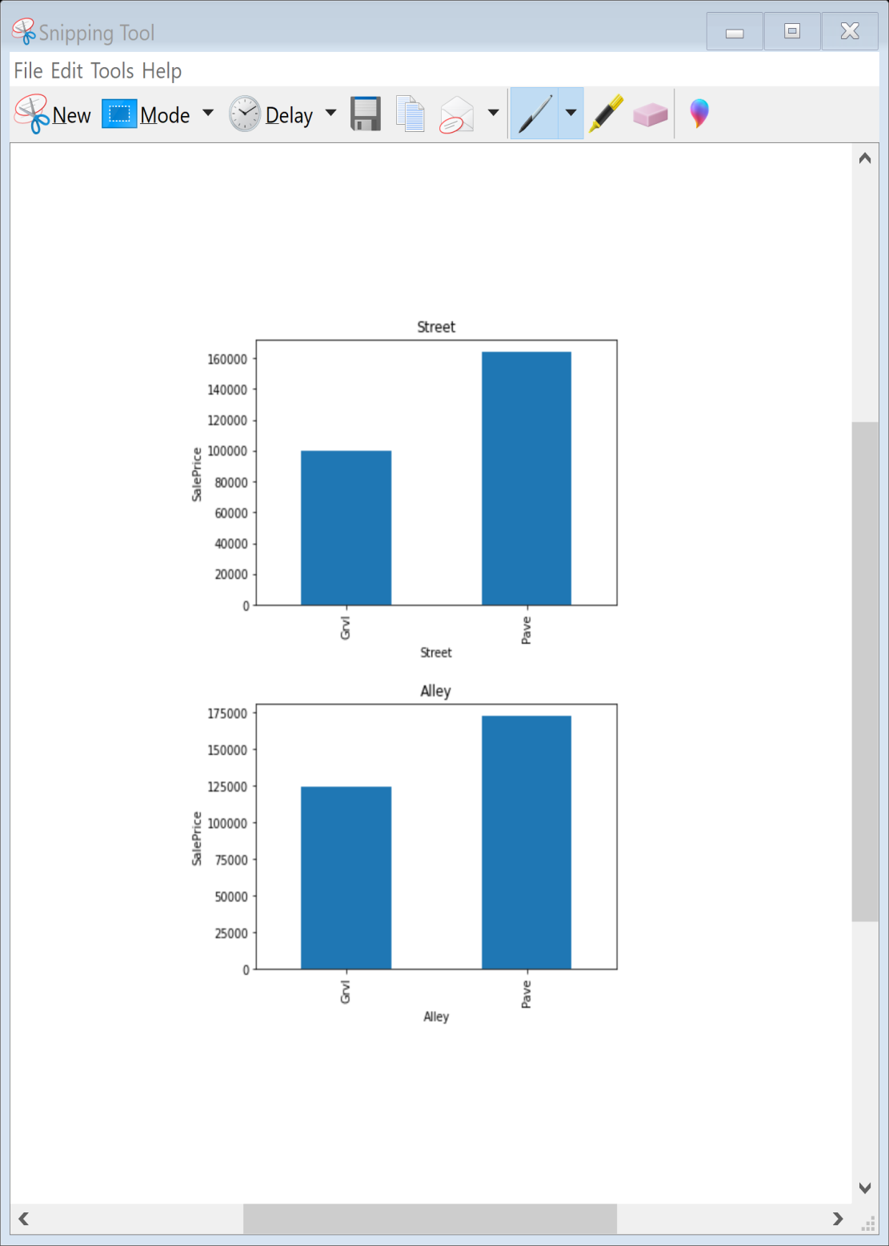
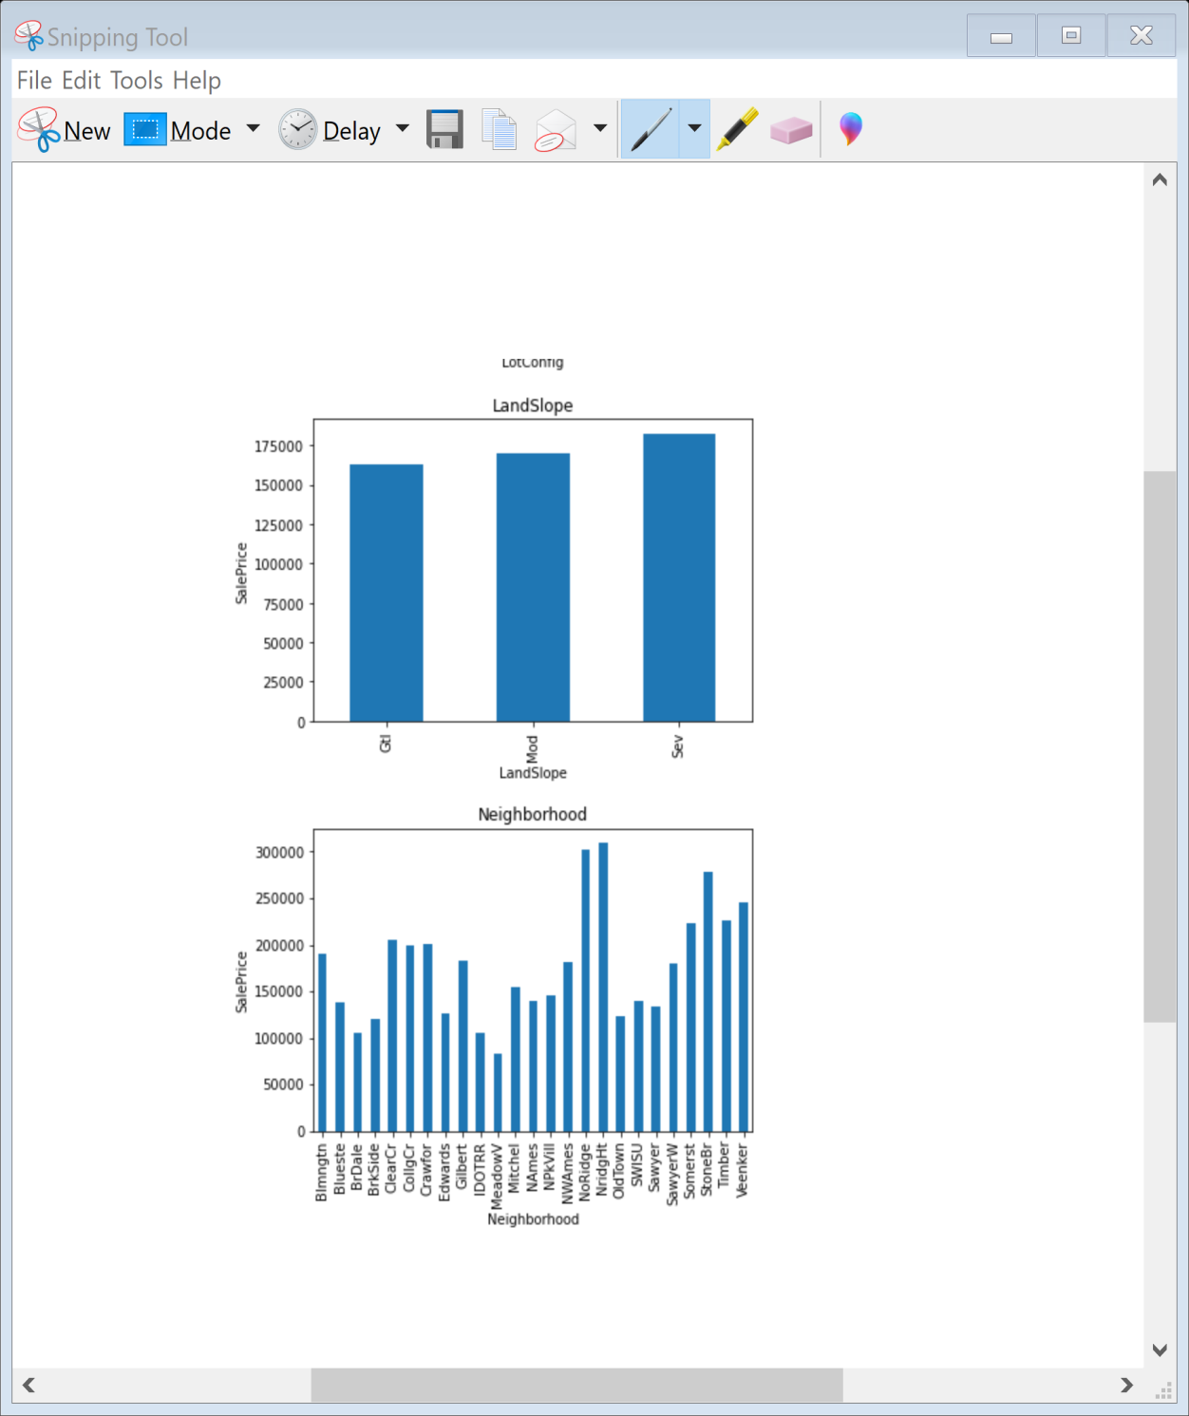
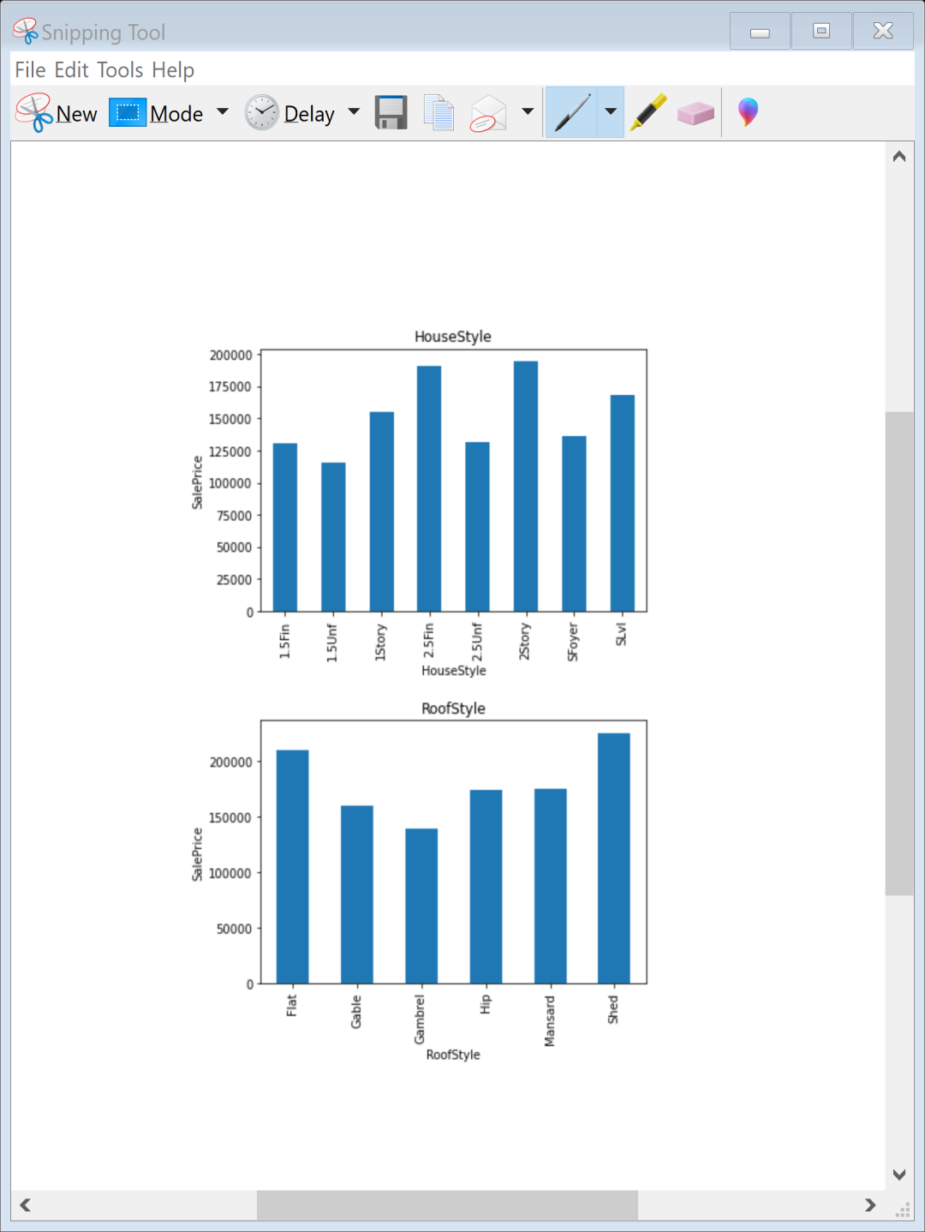
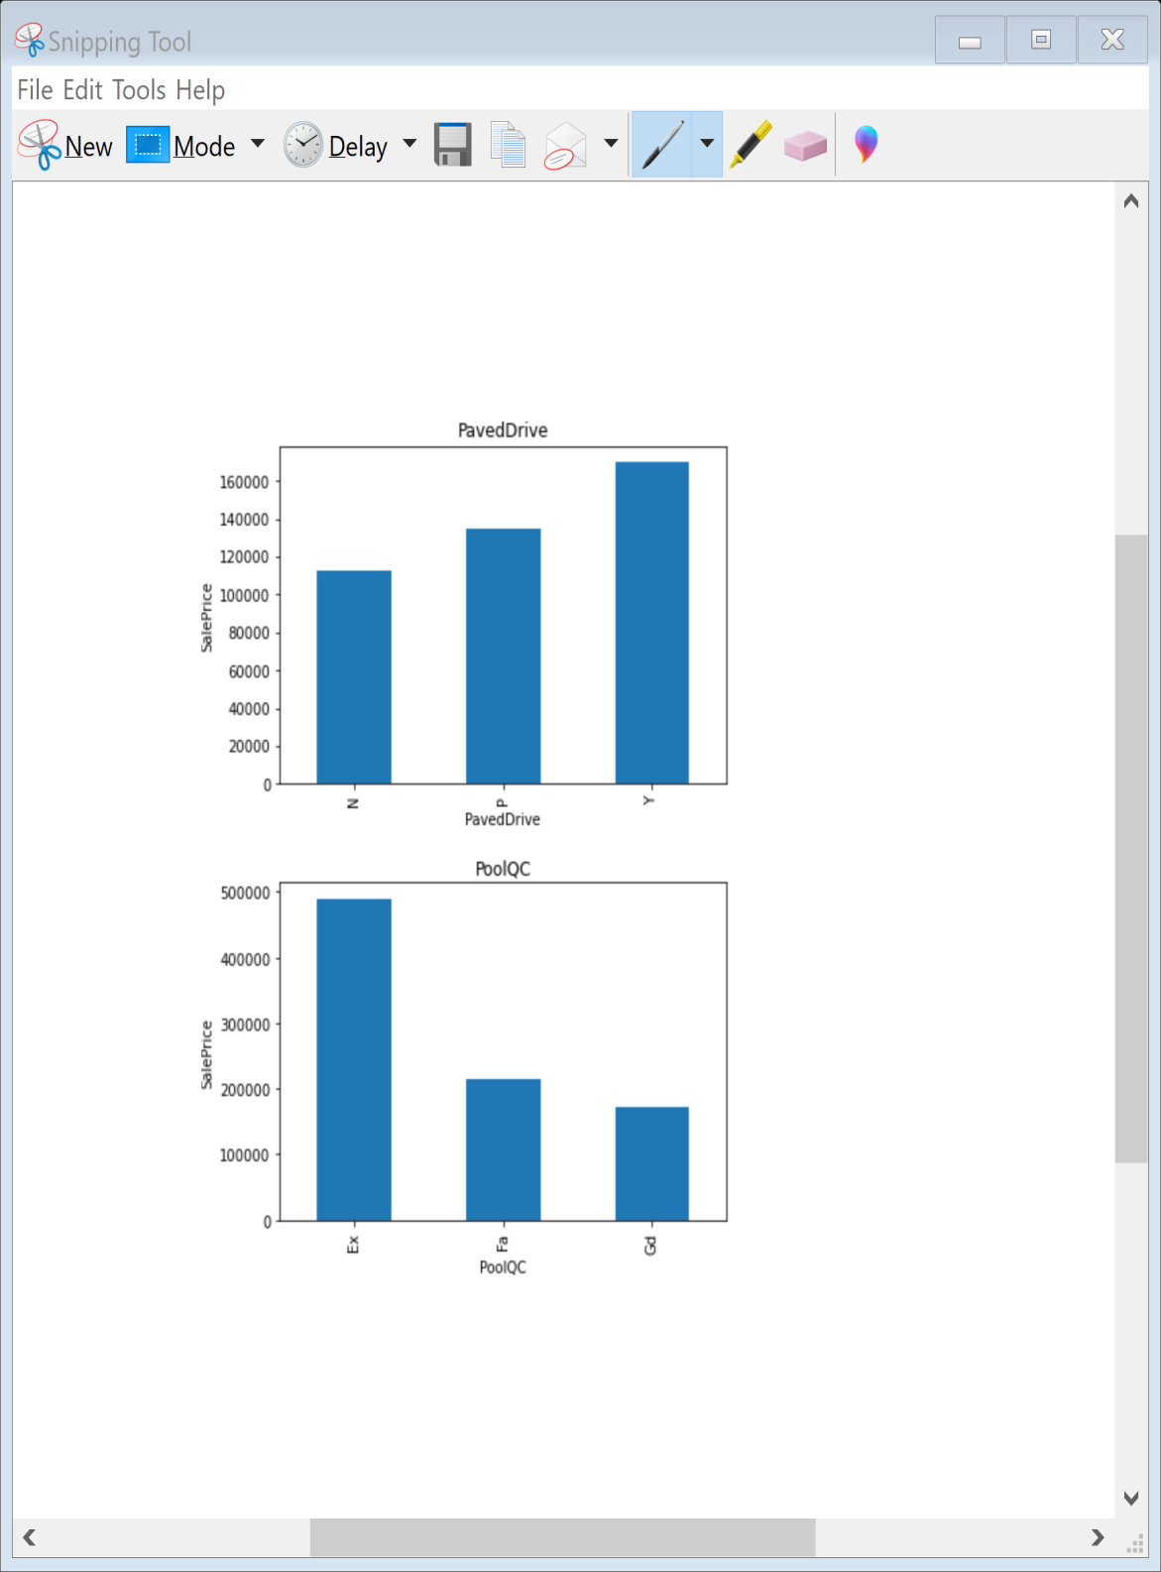
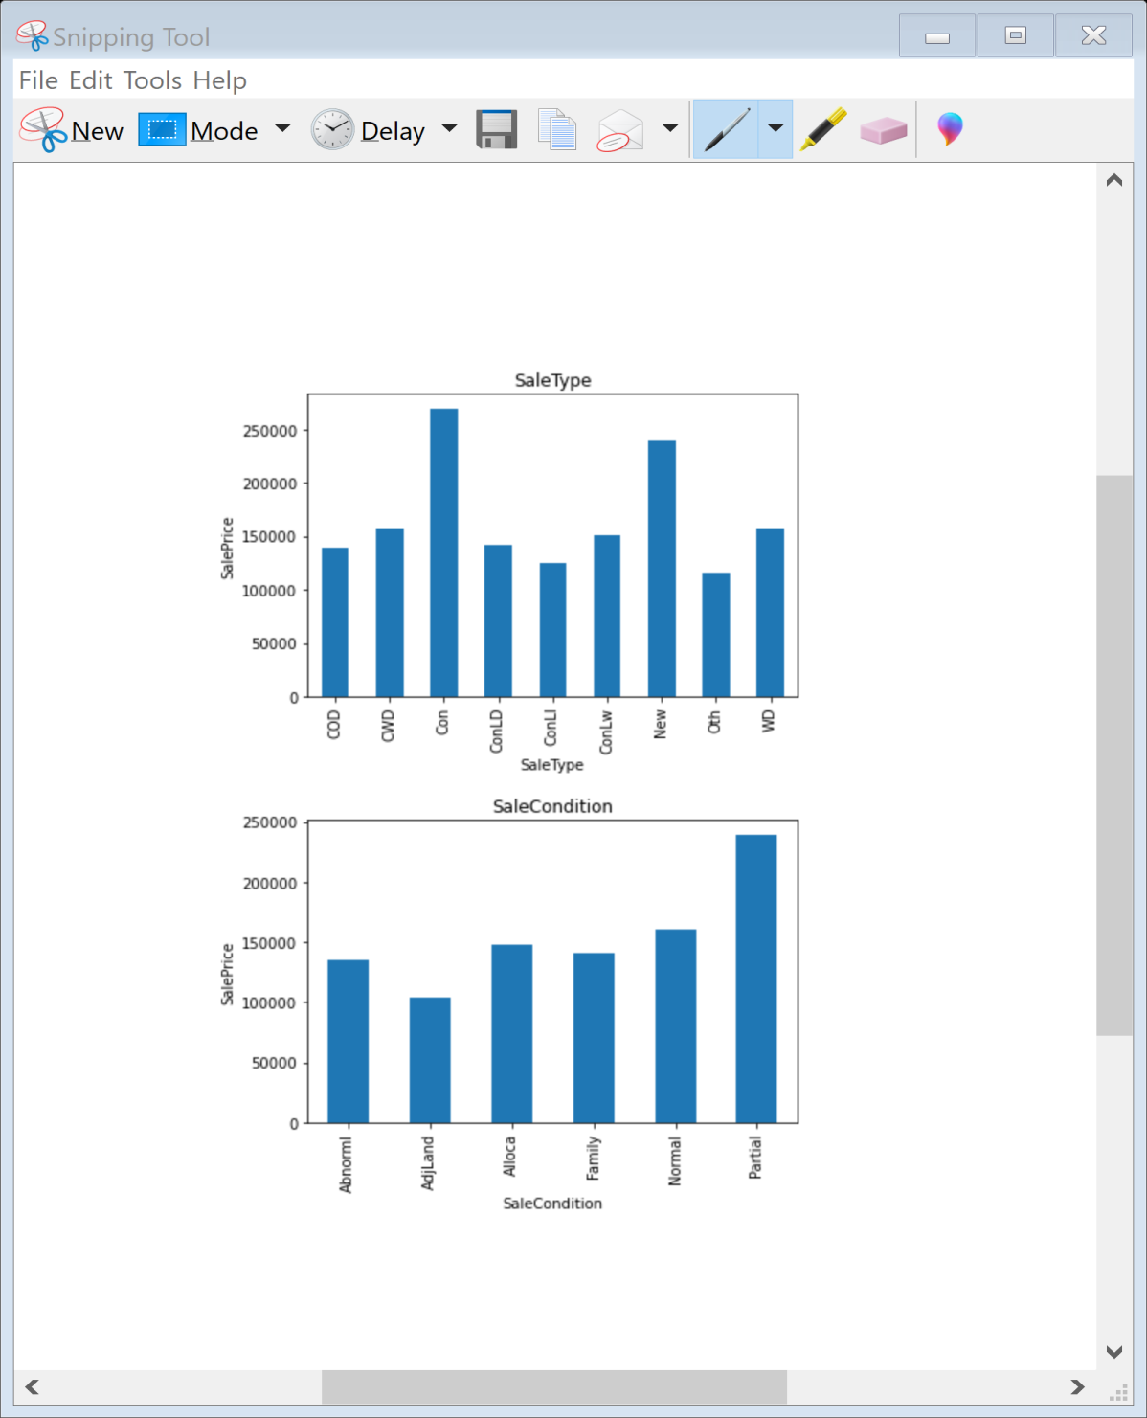
lets’s see the relationship between categorical feature and dependent variable.

Slide 15
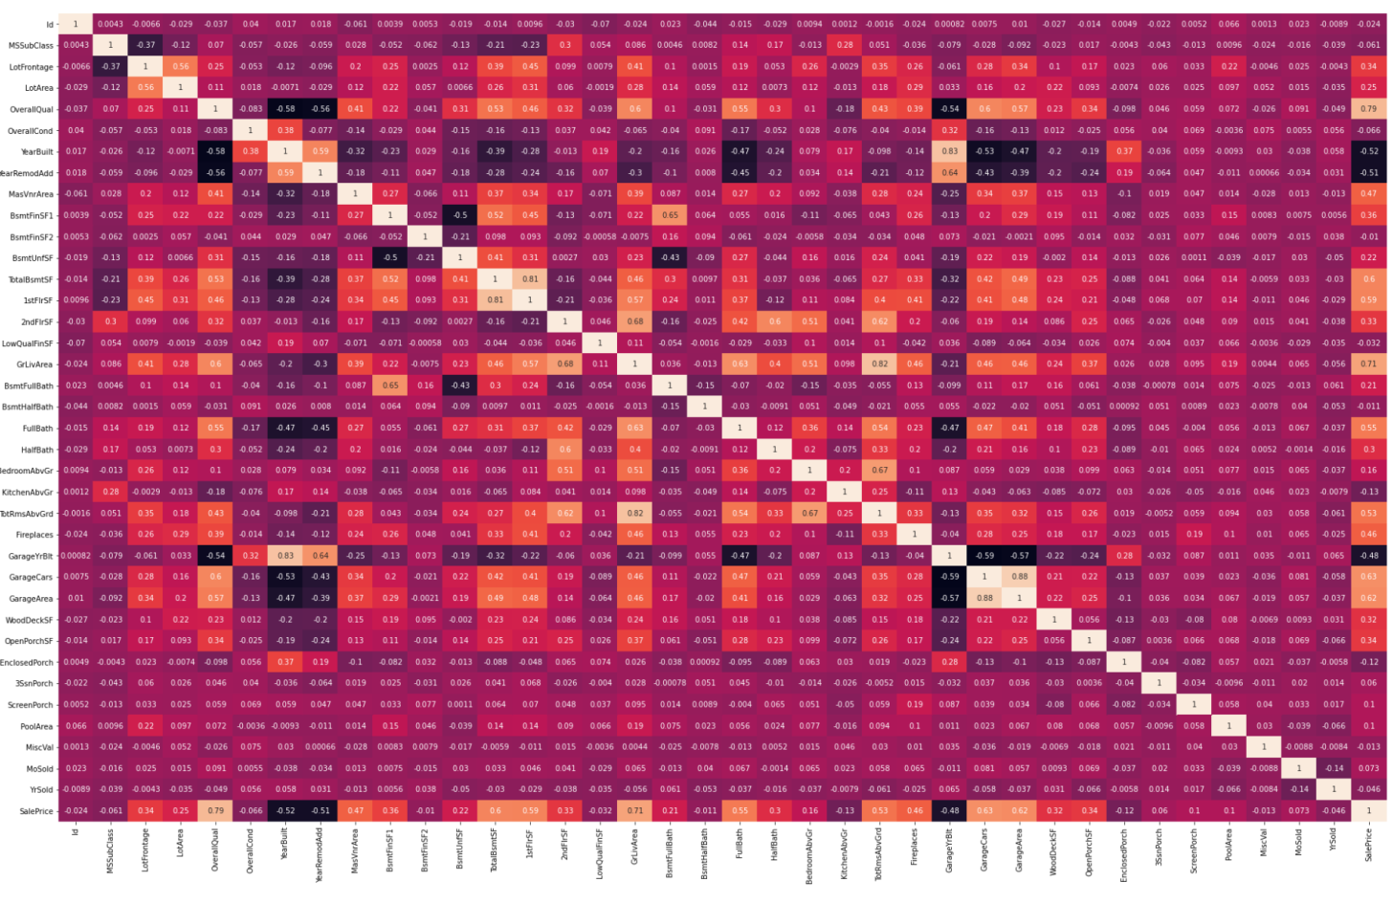
Statistical Analysis
In this we found that Variables like OverallQual (overall material and finish of the house ) , Year Built , TotRmsAbvGrd ( Total rooms above grade (does not include bathrooms) , GarageCars (Size of garage in car capacity ) ,GarageArea ( Size of garage in square feet ) , GrLivArea ( Above grade (ground) living area square feet ) , FullBath ( Full bathrooms above grade ) have positive relationship with the sales Price.
YearBuilt, YearRemodAdd, GarageYrBuilt are negatively related with sale price

Slide 16
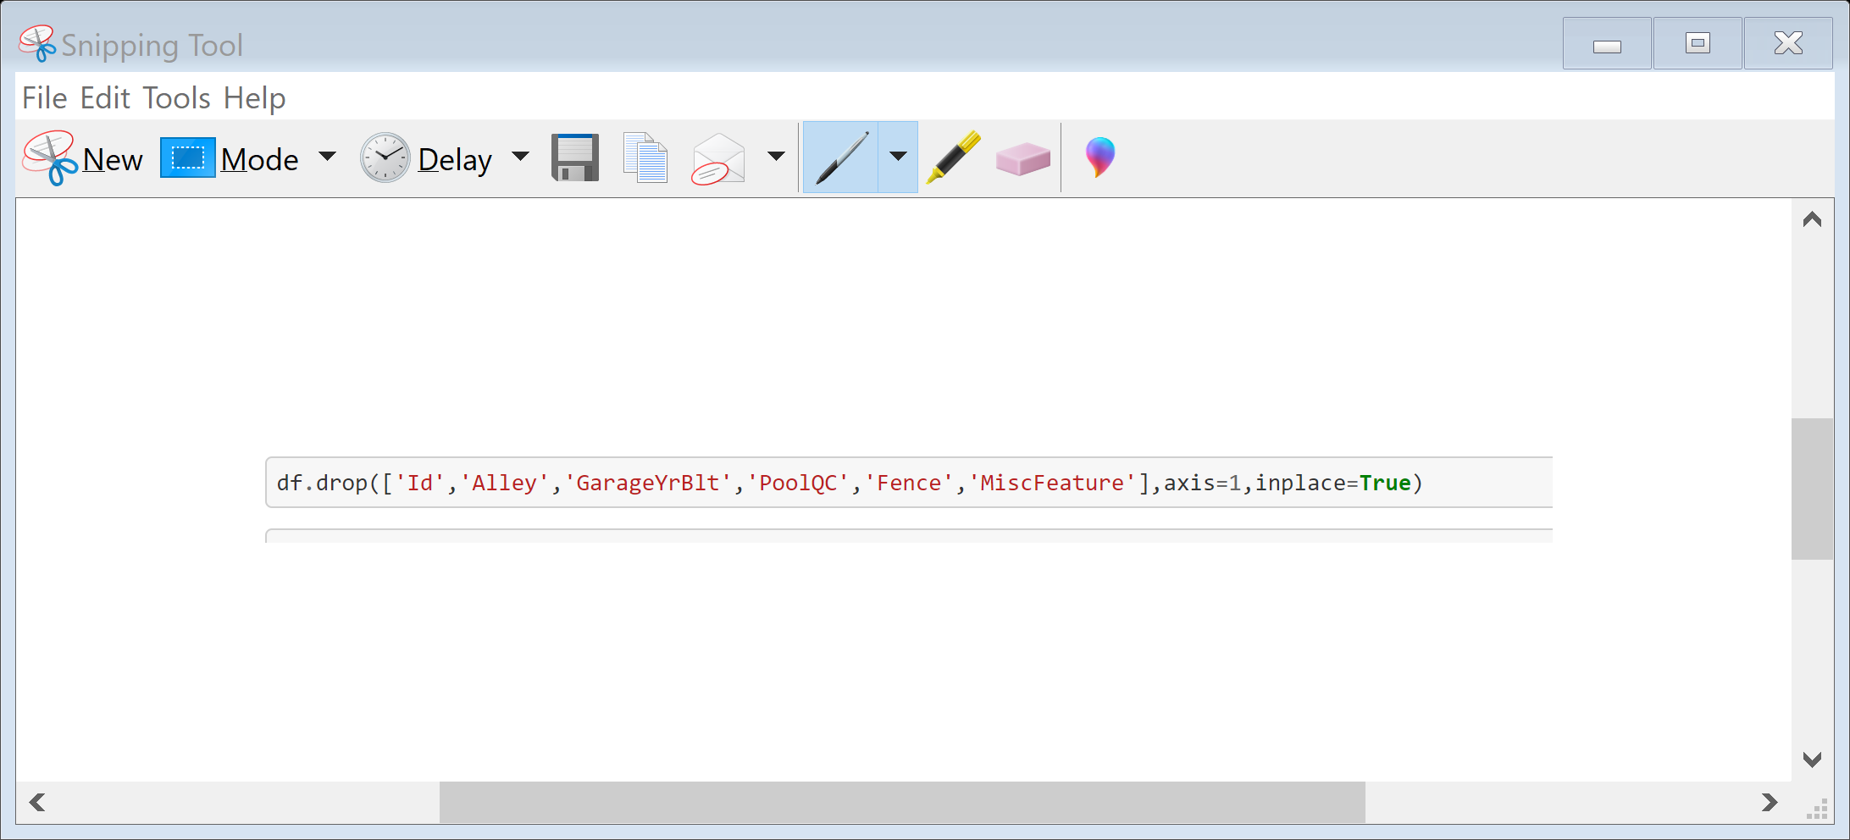
Data Preprocessing
First of all we will drop columns Alley , MiscFeature , PoolQC , Fence and GarageYrBlt because more than 80 % data in these columns are missing if we replace these missing data with some data it can give us wrong prediction in the final model thus making our model less effective so better to drop these columns.

Slide 17
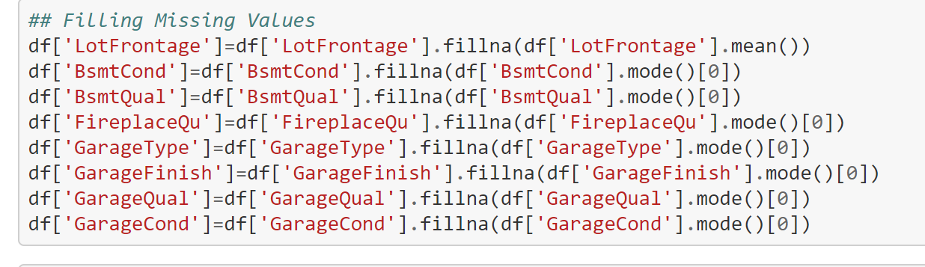
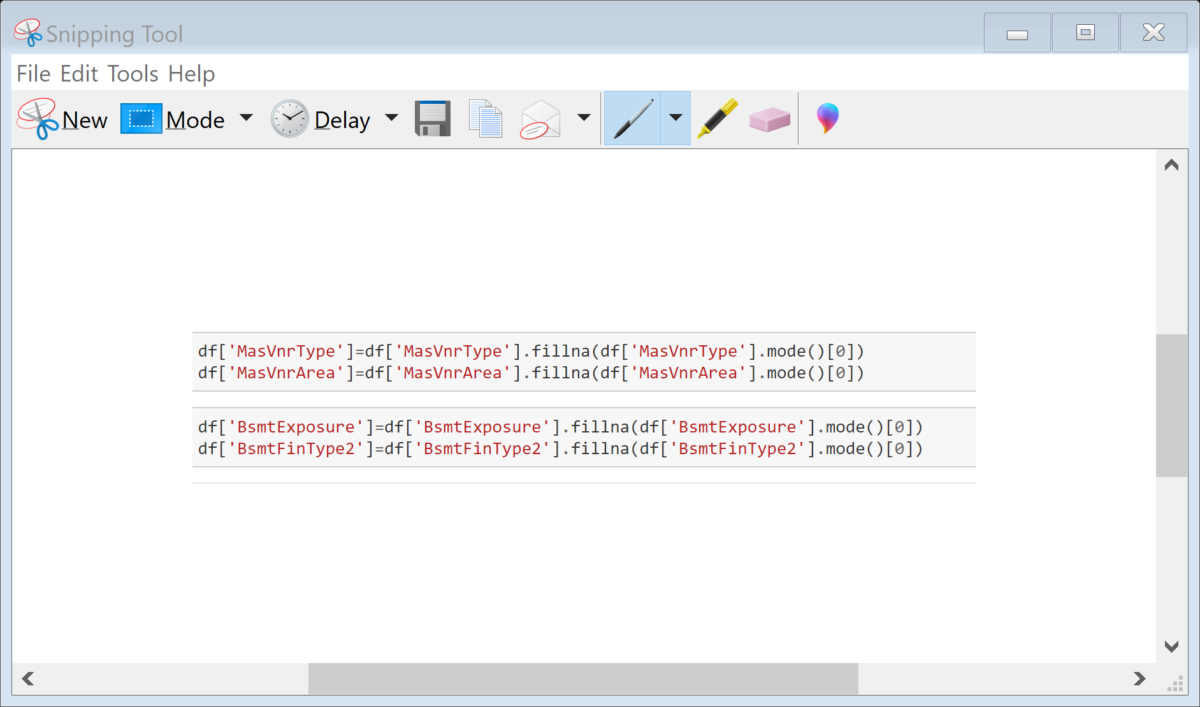
Now in the other columns GarageType, GarageFinish , GarageQual , GarageCond , BsmtFinType2 , BsmtExposure, Bsmtclond which have missing data of 10-20 % we will replace the missing data with the mode value .

Slide 18
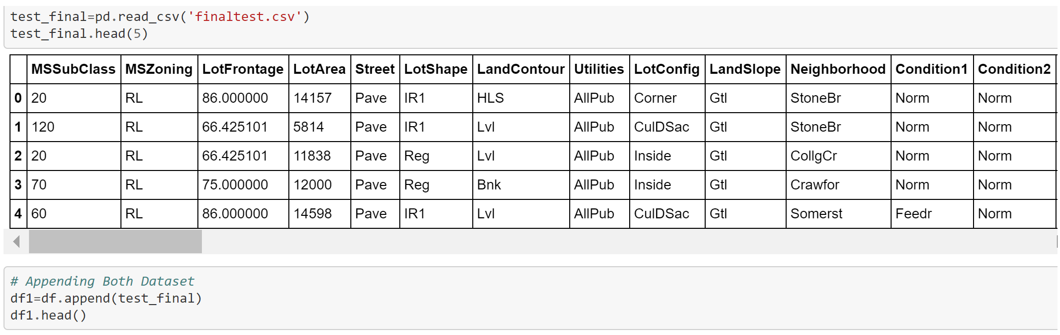
Now we will call our Finalised Test data set and append train and test data set .

Slide 19
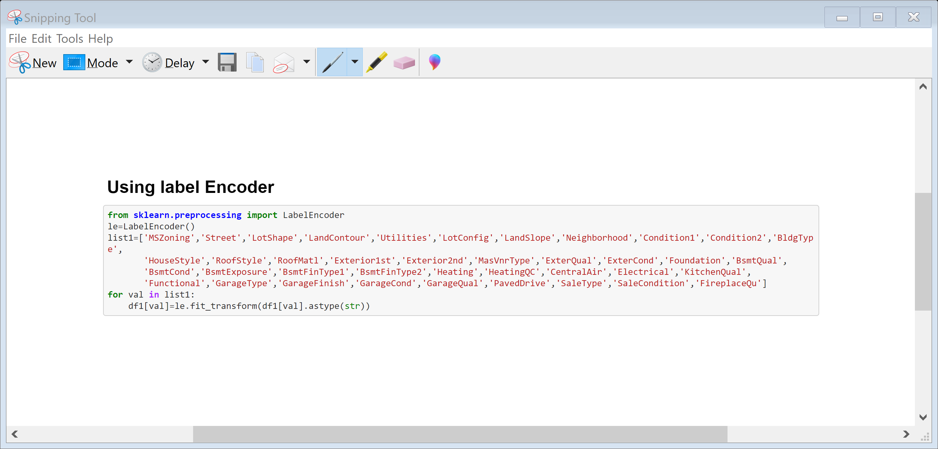
Now we will use label encoder to convert categorical data into numbers.

Slide 20
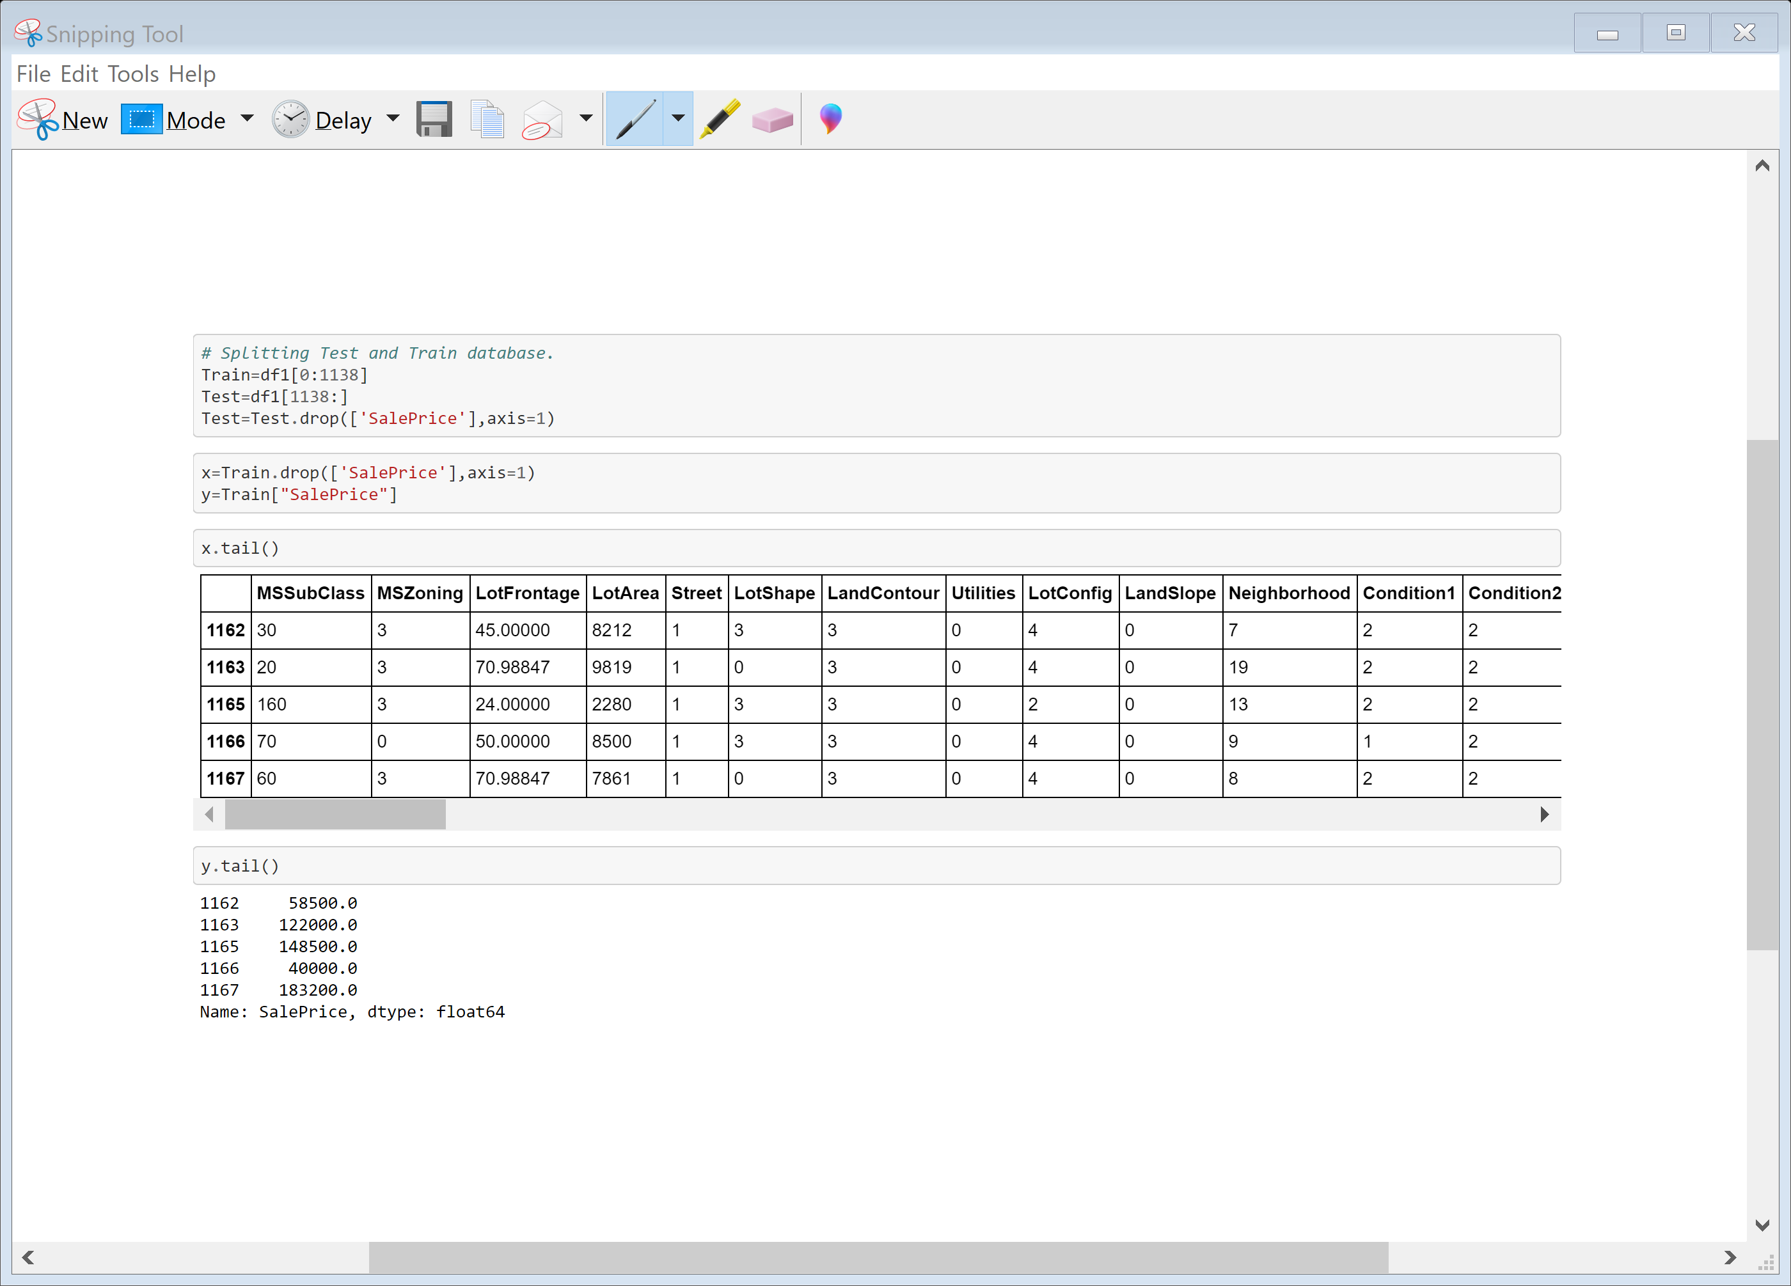
Now we will divide the data into input and output , the output will be ‘SalePrice’ and all the other remaining columns will be input.
Data Inputs- Logic- Output Relationships

Slide 21
Model/s Development and Evaluation
As we know that it is a Regression problem in which our output is ‘Sale Price’ so we will use the regression model like linear Regression , KNeighbors Regressor , Decision Tree Regressor, Gradient Boosting Regressor , Random Forest Regressor , Ada Boost Regressor etc we will train our training data using these algorithms and then we will test on the finalised test data set for final house price prediction . The algorithm which is giving better accuracy and Cross value score will be chosen as final model.

Slide 22
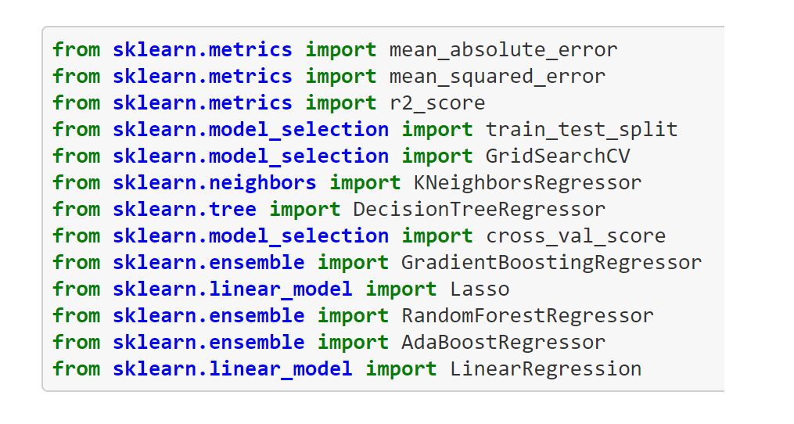
First we will load the necessary libraries .

Slide 23
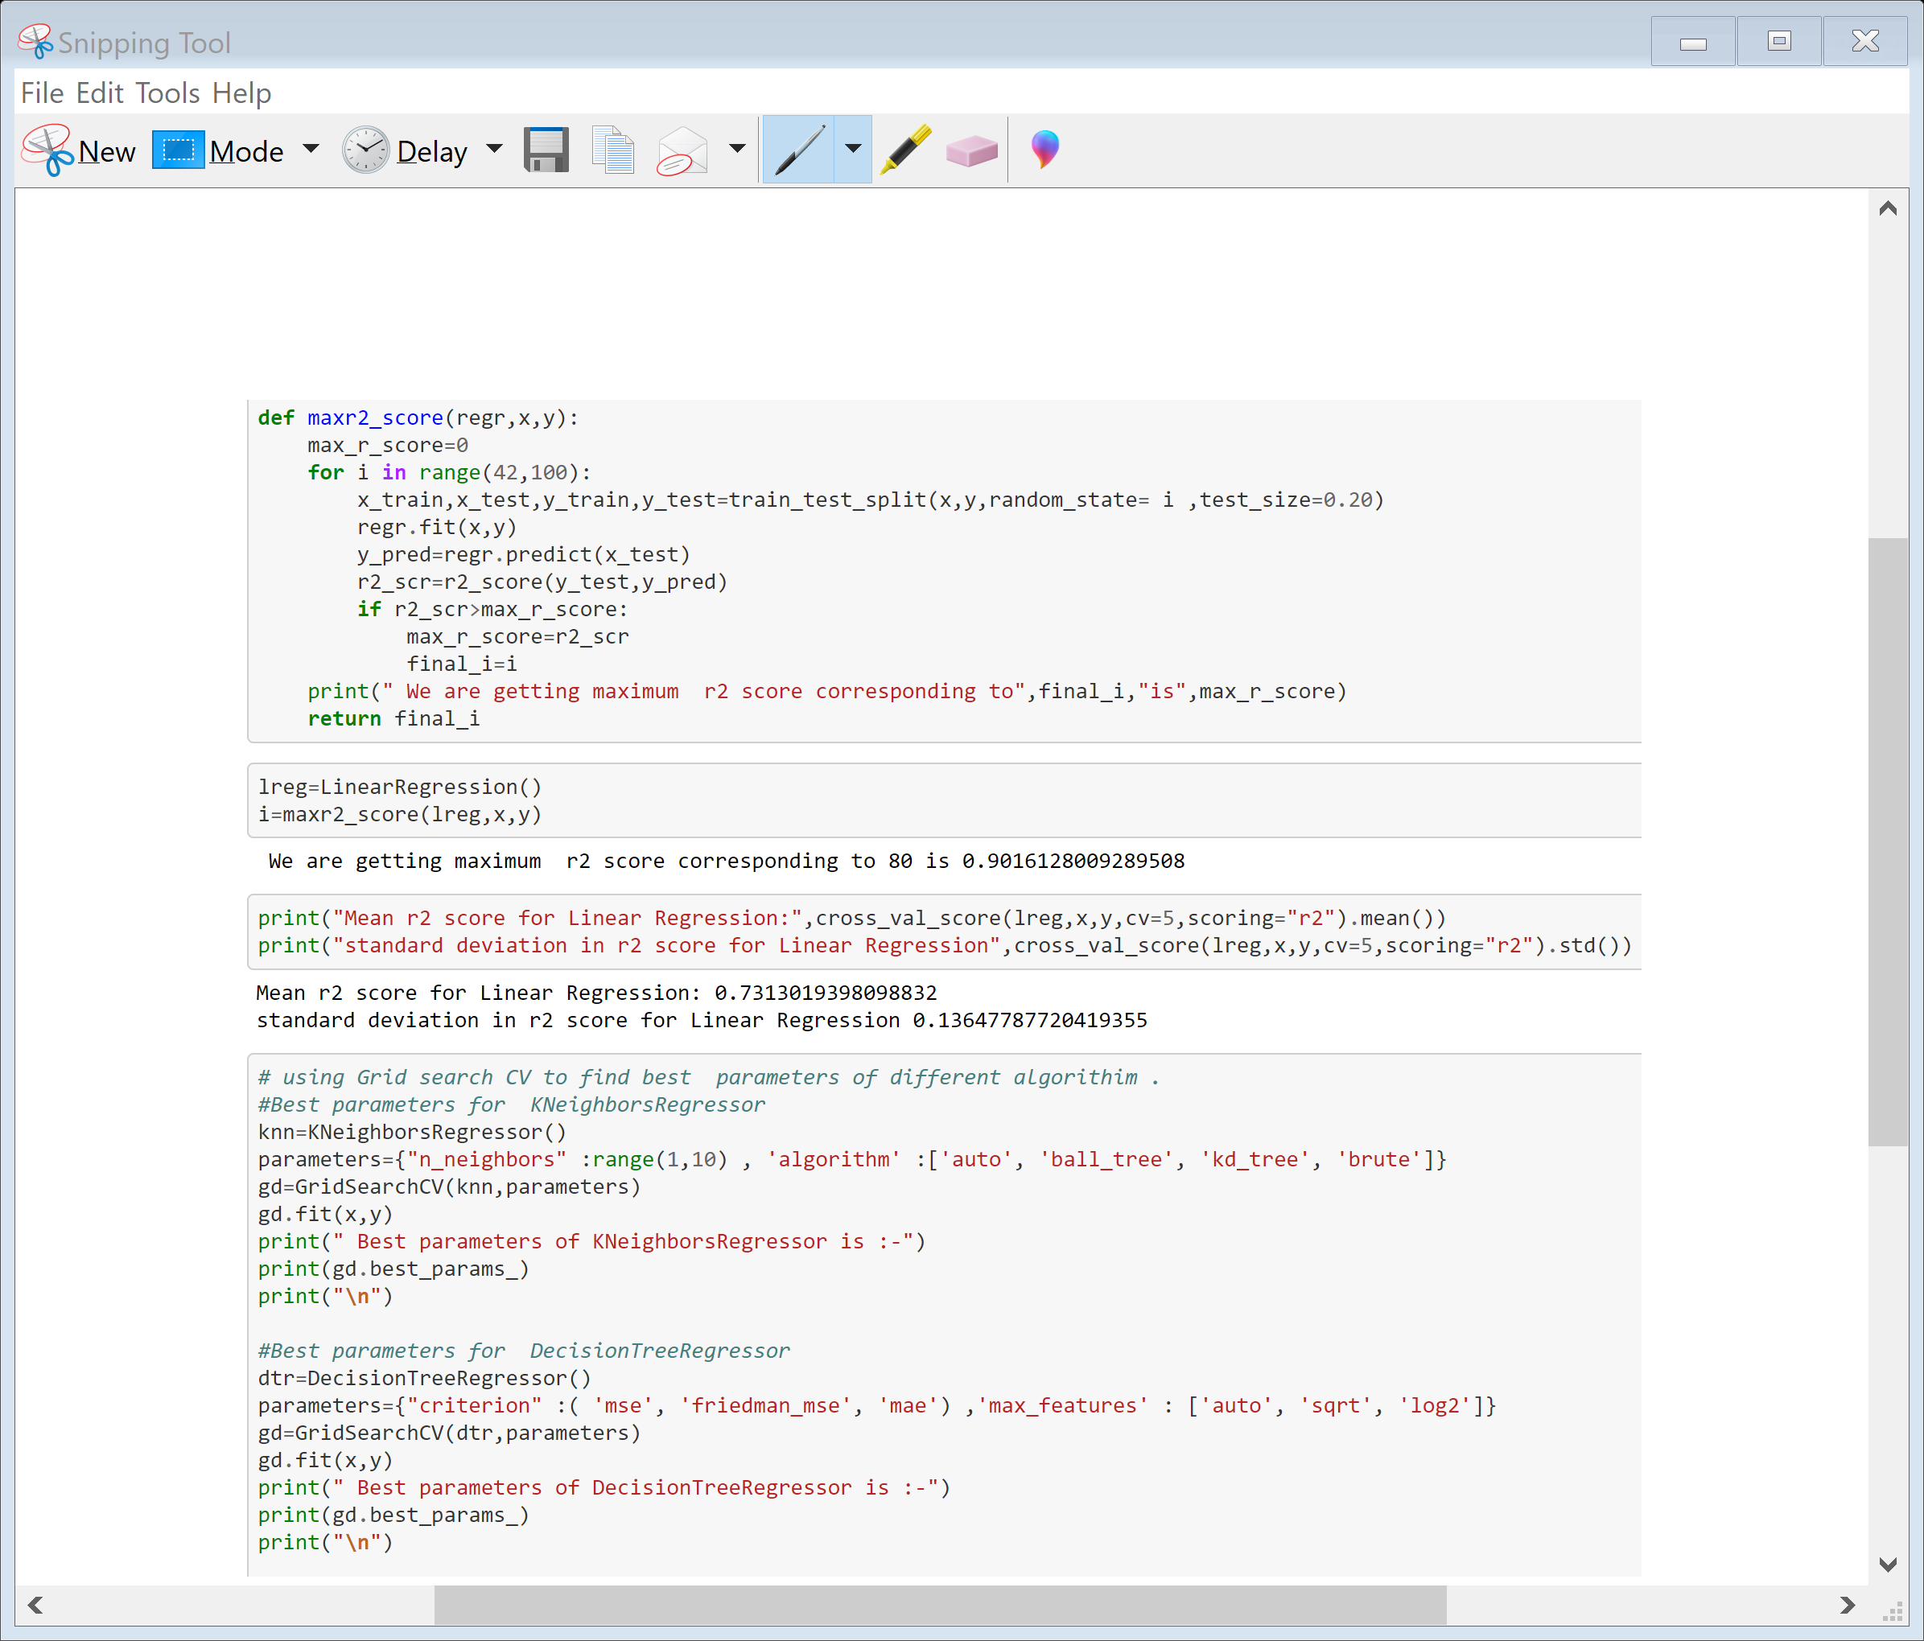
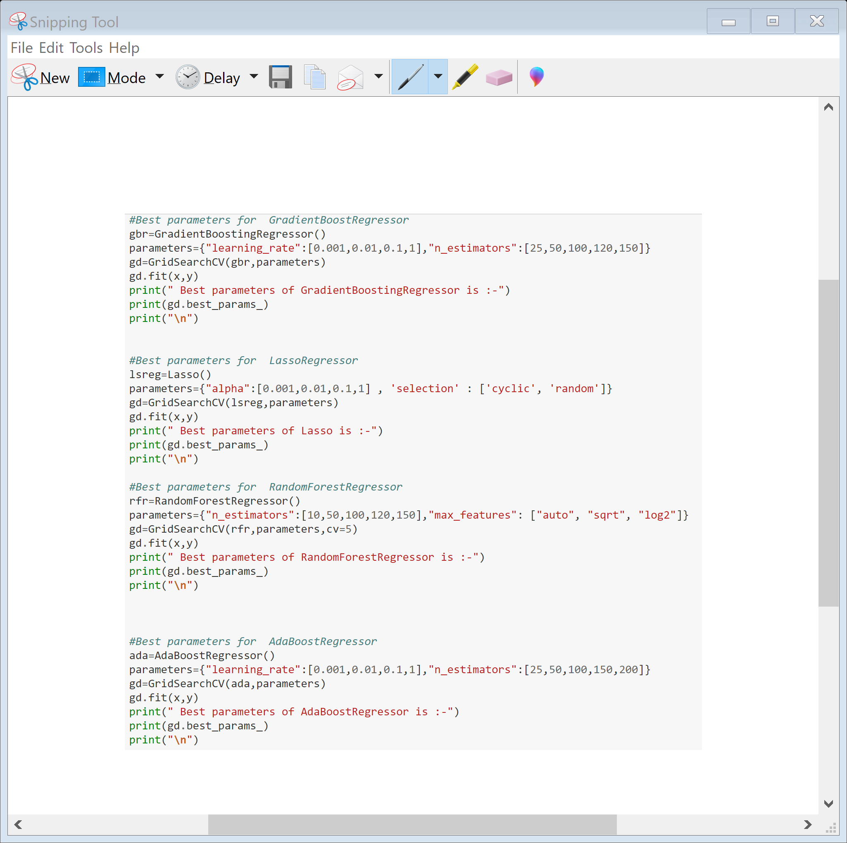
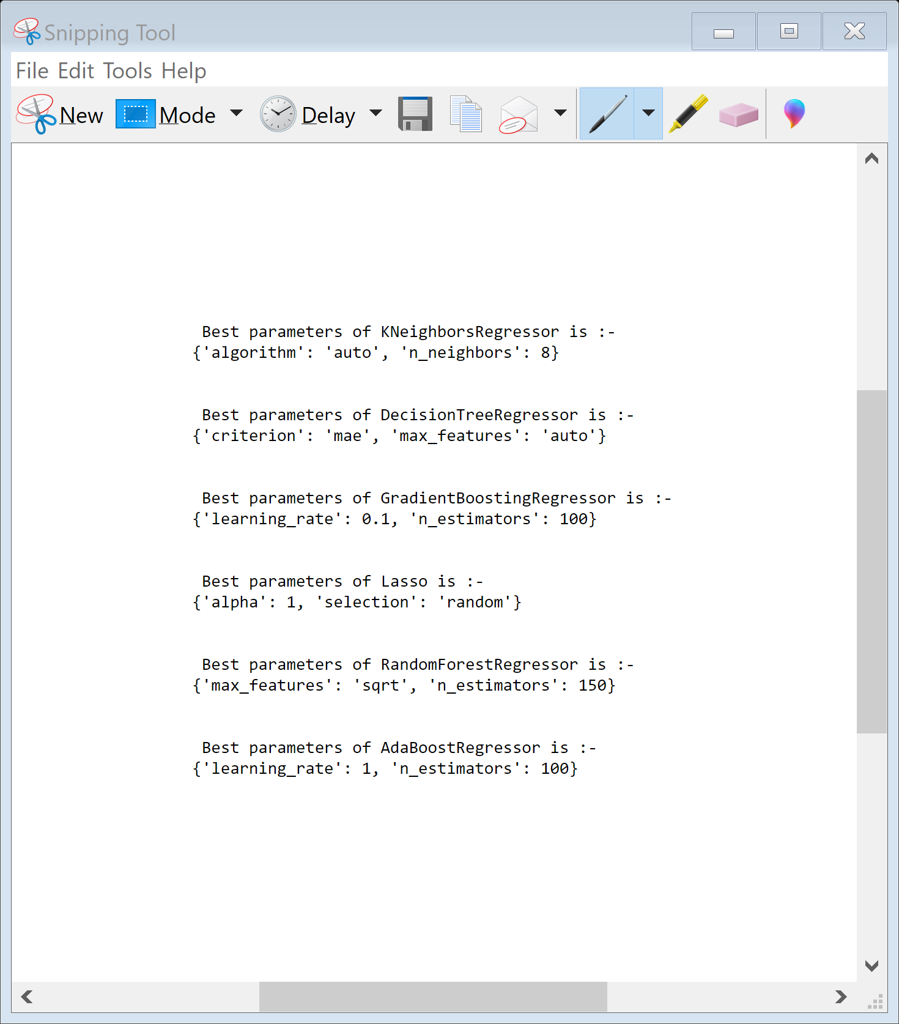
Now we will find best parameters of different algorithms

Slide 24
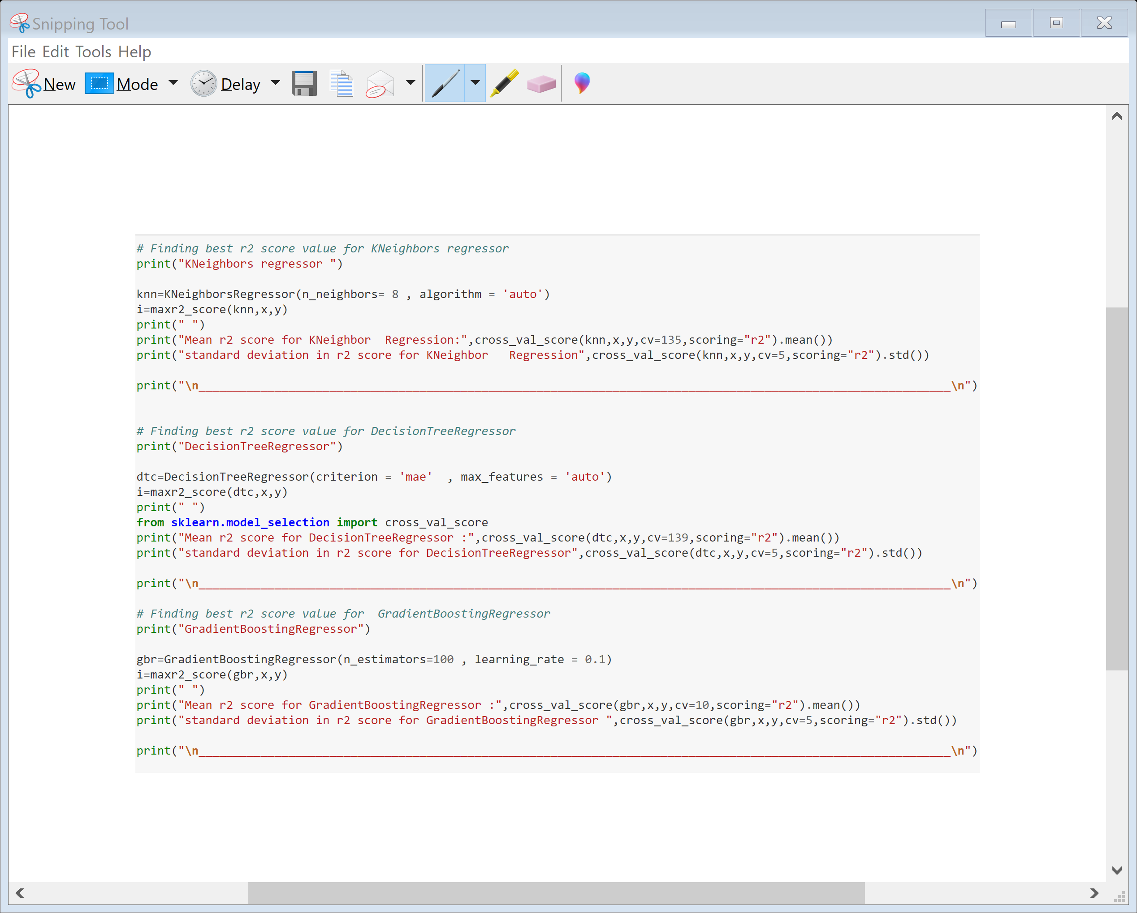
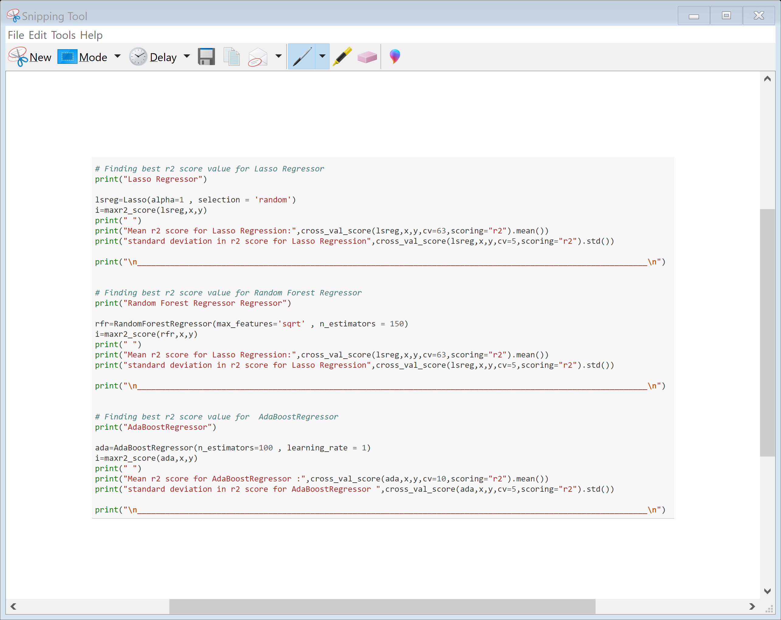
Now we will find the r2 score , cross value score and standard deviation of different algorithm.

Slide 25
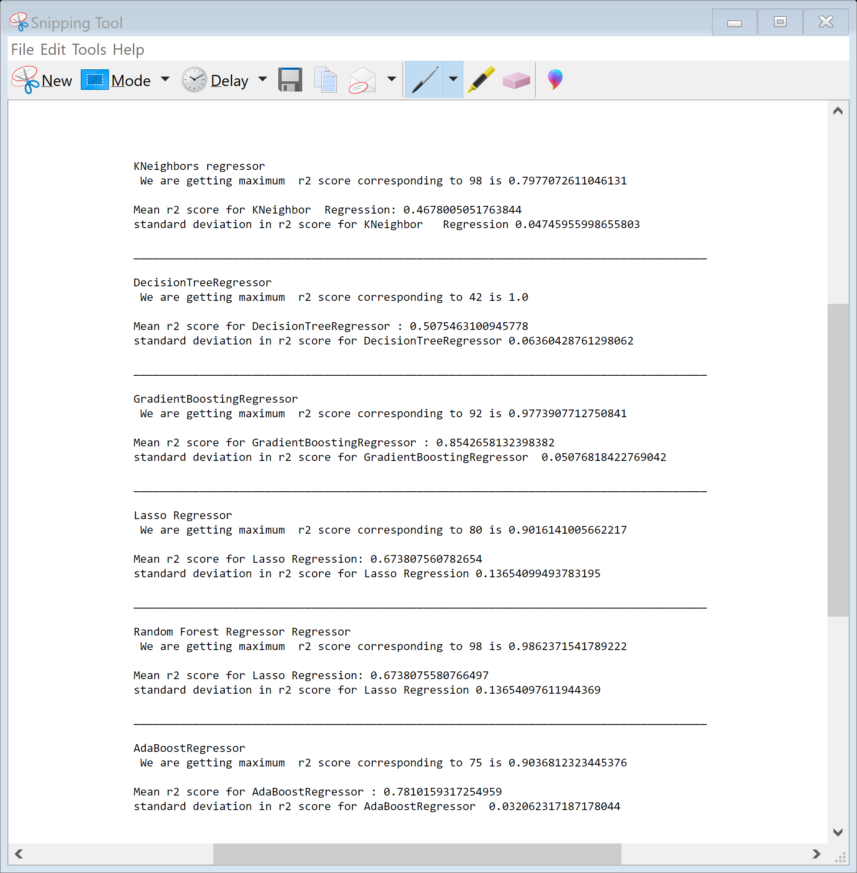
From the below running different algorithms we found that Gradient Boosting Regressor is giving better value of r2 score , cross value score and standard deviation so we will choose it as final model.

Slide 26
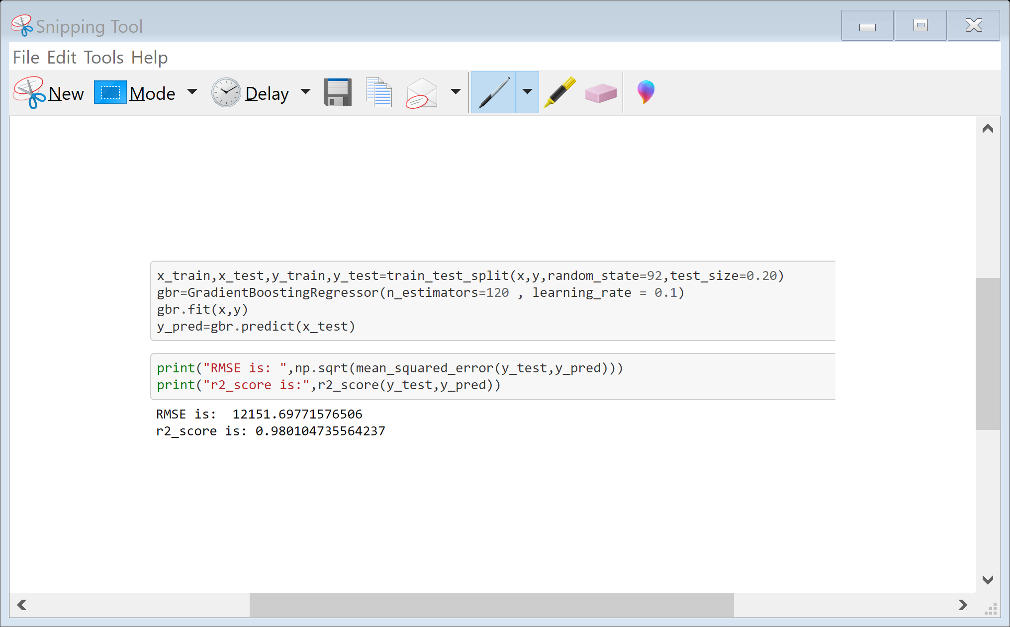
Since Gradient Boost Regressor is giving better result so we will use it as final model

Slide 27
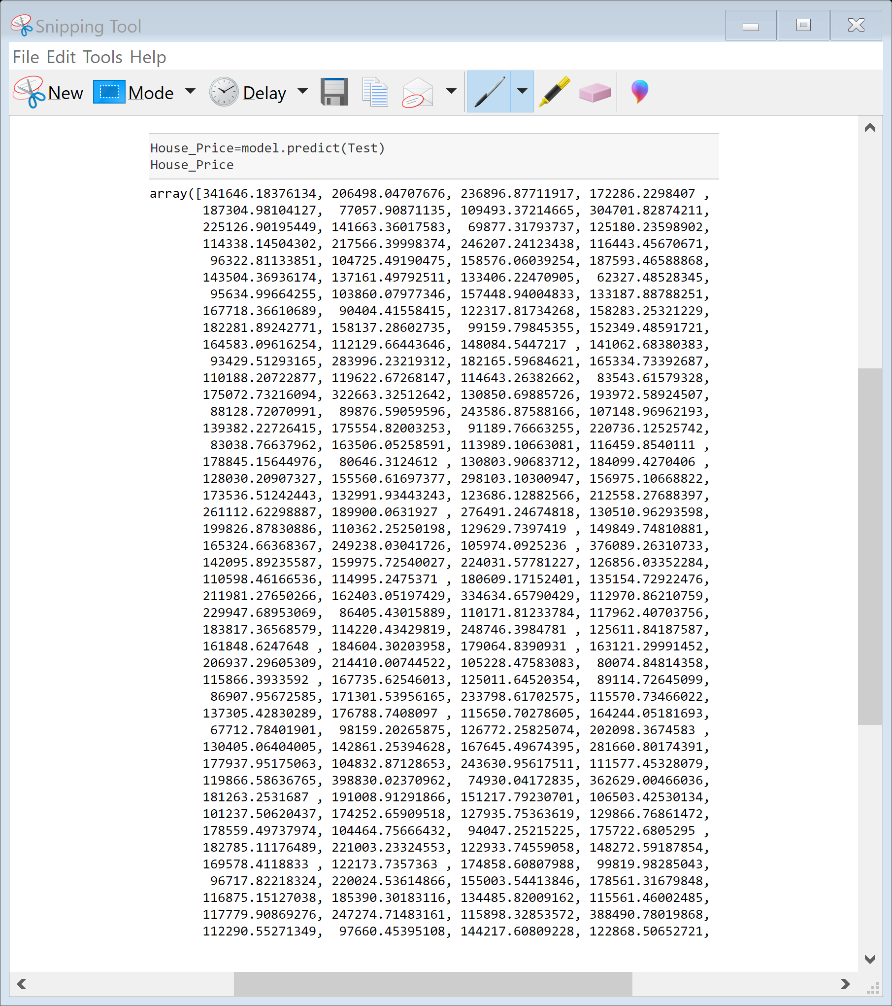
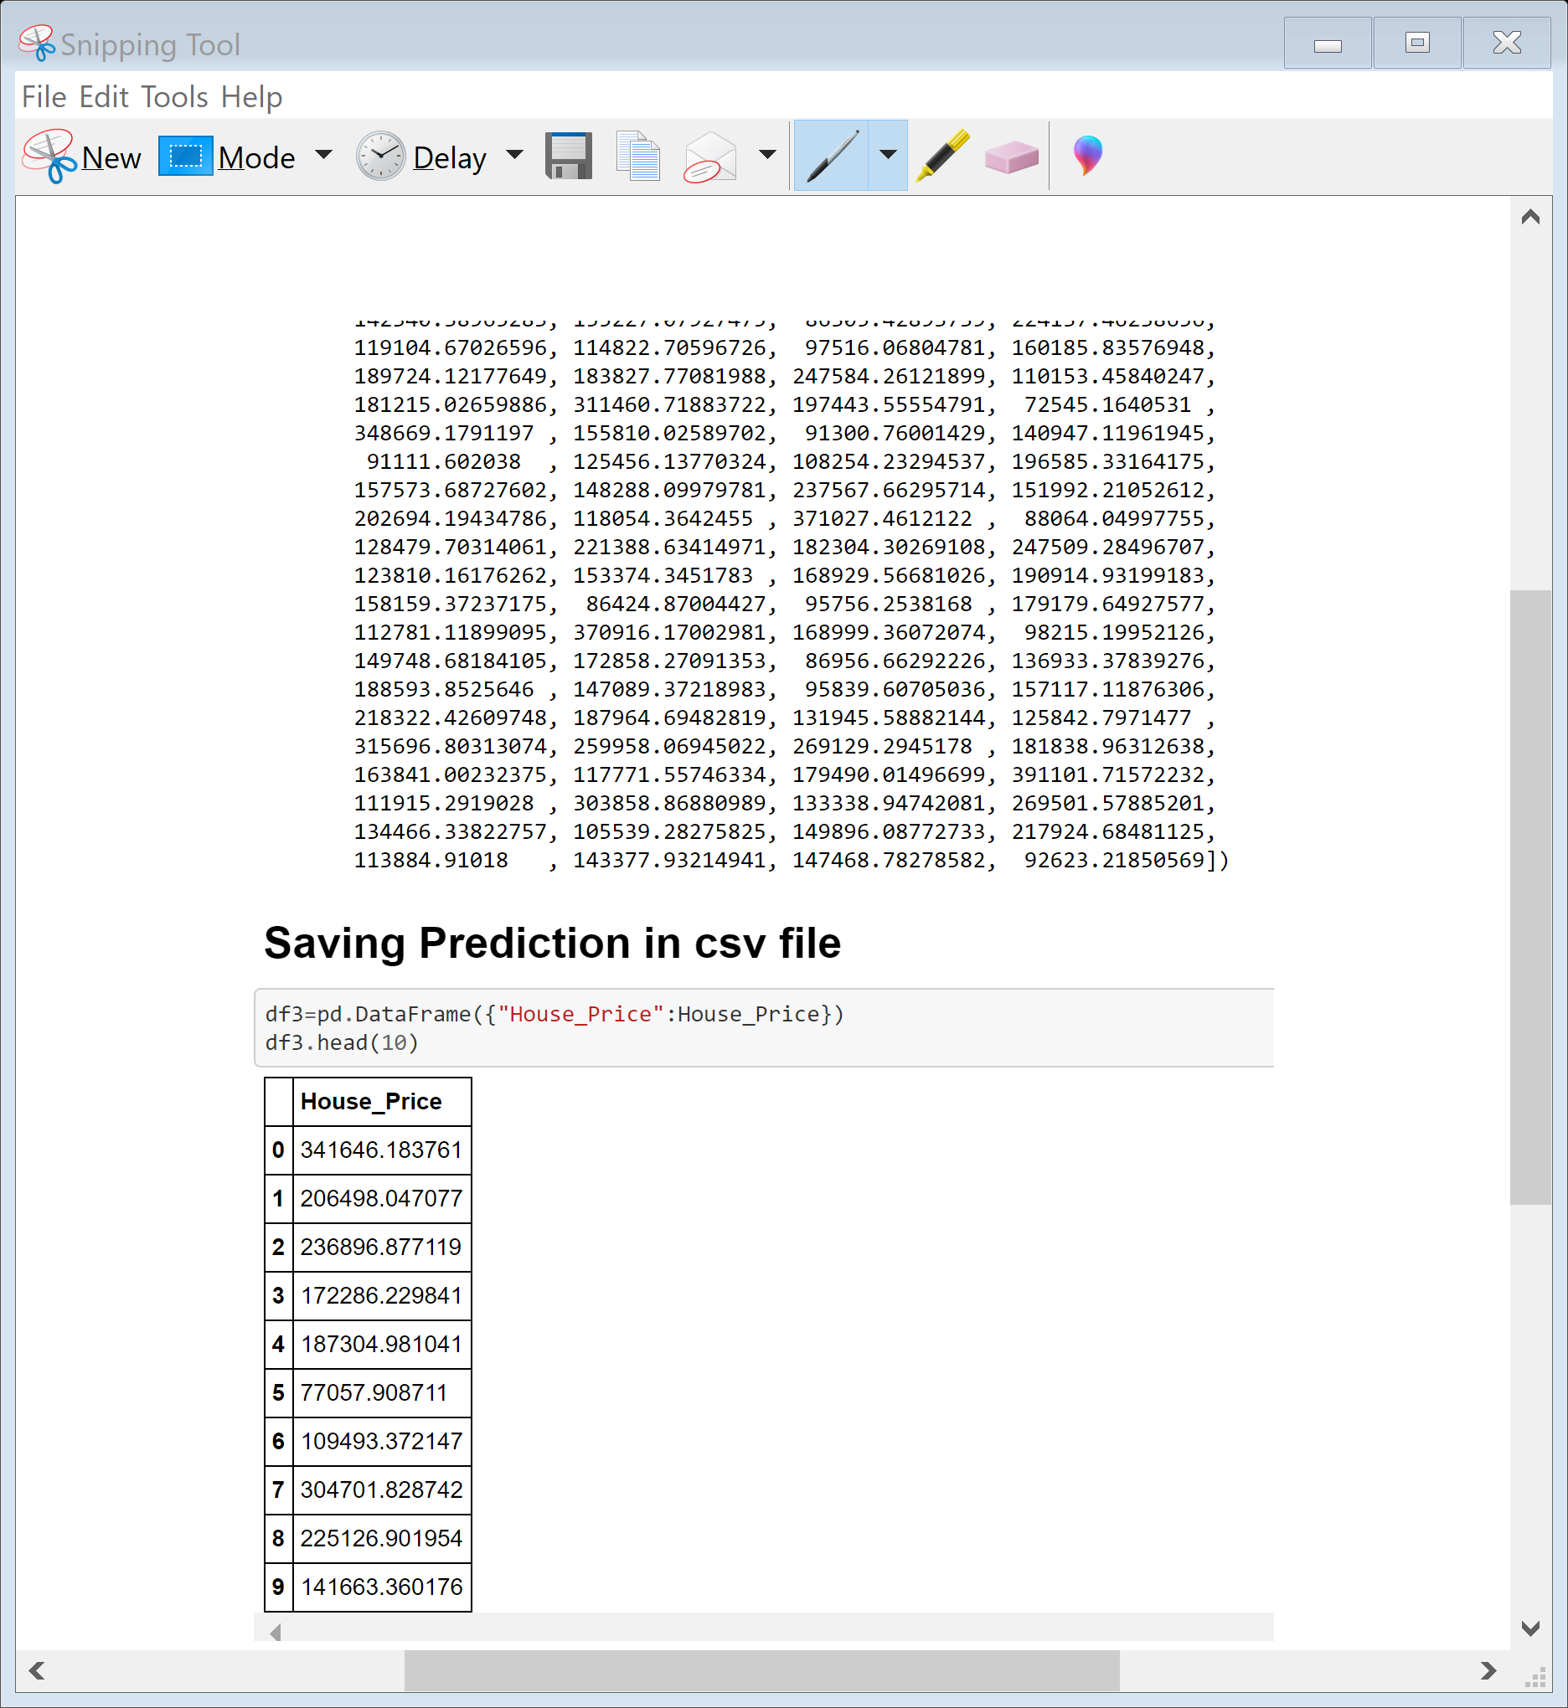
Now we will predict the sale price for our Test data

Slide 28
CONCLUSION Key Findings and Conclusions of the Study
In this we found that Variables like OverallQual (overall material and finish of the house ) , Year Built , TotRmsAbvGrd ( Total rooms above grade (does not include bathrooms) , GarageCars (Size of garage in car capacity ) ,GarageArea ( Size of garage in square feet ) , GrLivArea ( Above grade (ground) living area square feet ) , FullBath ( Full bathrooms above grade ) have positive relationship with the sales Price and they effect the sales price hence these factors should be considered

Slide 29
Learning Outcomes of the Study in respect of Data Science
The goal is to achieve the system which will reduce the human effort to find a house having reasonable price. The proposed system. House Price Prediction model approximately try to achieve the same one. Proposed system focused on predict the house price according to the area for that image processing and machine learning methods are used. The experimental results showed that this technique that are used while developing system will give accurate prediction of house price

